Slide 1



Graduation IN Informatics engineering
Backend Node.js, Express, MySQL, Angular
■ Course Unit: Project III
Luís Alonso 17506
■ Coordinator: Prof. Doctor Jorge Ribeiro
Instituto Politécnico de Viana do Castelo
Escola Superior de Tecnologia e Gestão
www.ipvc.pt
School Year: 2020/2021

Slide 2
Graduation IN Informatics engineering
■ Summary
Project III
1. Introduction and Objectives
2. Technologies, Tools, Frameworks
2.1 Node
2.2 Express
2.3 MySQL
2.4 CORS
2.5 BodyParser
2.6 Sequelize
2.7 JWT
2.8 Bcryptjs
3. Diagrams
3.1 Application Architecture
3.2 Flow for Signup & Login with JWT Authentication
3.3 API EndPoint’s
3.4 Tables created in the DataBase
4. Implementation
5. Postman Testing
6. GitHub Repository
7. Conclusion and Future Work
8. Bibliography and Web References
@2020/2021 – Luis Alonso 17506– Backend Node.js, Express, MySQL
- 2 -

Slide 3
Graduation IN Informatics engineering
Introduction and Objectives
Project III
In this phase i will implent the authentication system for the Project, using JsonWebTokens.
I will create a REST API using Node.js, Express and MySQL.
I will also use:
CORS Body-Parser,
Sequelize,
JsonWebToken,
Bcryptjs.
@2020/2021 – Luis Alonso 17506– Backend Node.js, Express, MySQL
- 3 -

Slide 4

Graduation IN Informatics engineering
2.1 Technologies, Tools, Frameworks
Project III
Node.js is a free, open-sourced, cross-platform JavaScript run-time environment that lets developers write command line tools and server-side scripts outside of a browser.
@2020/2021 – Luis Alonso 17506– Backend Node.js, Express, MySQL
- 4 -

Slide 5

Graduation IN Informatics engineering
2.2 Technologies, Tools, Frameworks
Project III
ExpressJS is a web application framework that provides you with a simple API to build websites, web apps and back ends. With ExpressJS, you need not worry about low level protocols, processes, etc.
@2020/2021 – Luis Alonso 17506– Backend Node.js, Express, MySQL
- 5 -

Slide 6

Graduation IN Informatics engineering
2.3 Technologies, Tools, Frameworks
Project III
MySQL is an Oracle-backed open source relational database management system (RDBMS) based on Structured Query Language (SQL). MySQL runs on virtually all platforms, including Linux, UNIX and Windows. Although it can be used in a wide range of applications, MySQL is most often associated with web applications and online publishing.
@2020/2021 – Luis Alonso 17506– Backend Node.js, Express, MySQL
- 6 -

Slide 7
Graduation IN Informatics engineering
2.4 Technologies, Tools, Frameworks
Project III
Cross-Origin Resource Sharing (CORS)
Cross-Origin Resource Sharing (CORS) is a mechanism that uses additional HTTP headers to tell a browser to let a web application running at one origin (domain) have permission to access selected resources from a server at a different origin. A web application executes a cross-origin HTTP request when it requests a resource that has a different origin (domain, protocol, and port) than its own origin.
@2020/2021 – Luis Alonso 17506– Backend Node.js, Express, MySQL
- 7 -

Slide 8
Graduation IN Informatics engineering
2.5 Technologies, Tools, Frameworks
Project III
CORS BodyParser
Parse incoming request bodies in a middleware before your handlers, available under the req.body property.
@2020/2021 – Luis Alonso 17506– Backend Node.js, Express, MySQL
- 8 -

Slide 9

Graduation IN Informatics engineering
2.6 Technologies, Tools, Frameworks
Project III
Sequelize is a promise-based Node.js ORM for Postgres, MySQL, MariaDB, SQLite and Microsoft SQL Server. It features solid transaction support, relations, eager and lazy loading, read replication and more.
@2020/2021 – Luis Alonso 17506– Backend Node.js, Express, MySQL
- 9 -

Slide 10

Graduation IN Informatics engineering
2.7 Technologies, Tools, Frameworks
Project III
JsonWebToken
JSON Web Token (JWT) is an open standard (RFC 7519) that defines a compact and self-contained way for securely transmitting information between parties as a JSON object. This information can be verified and trusted because it is digitally signed. JWTs can be signed using a secret (with the HMAC algorithm) or a public/private key pair using RSA or ECDSA.
In this Project the secret will be: “Eindhoven”.
@2020/2021 – Luis Alonso 17506– Backend Node.js, Express, MySQL
- 10 -

Slide 11

Graduation IN Informatics engineering
2.8 Technologies, Tools, Frameworks
Project III
BCrypt.js is a module used to encrypt the user credentials before storing them in the DataBase.
This way, we do not store users’ passwords in the database in its original form. Instead, a password is stored in a complex combination of text and unique characters; this is known as a password hash method.
@2020/2021 – Luis Alonso 17506– Backend Node.js, Express, MySQL
- 11 -

Slide 12
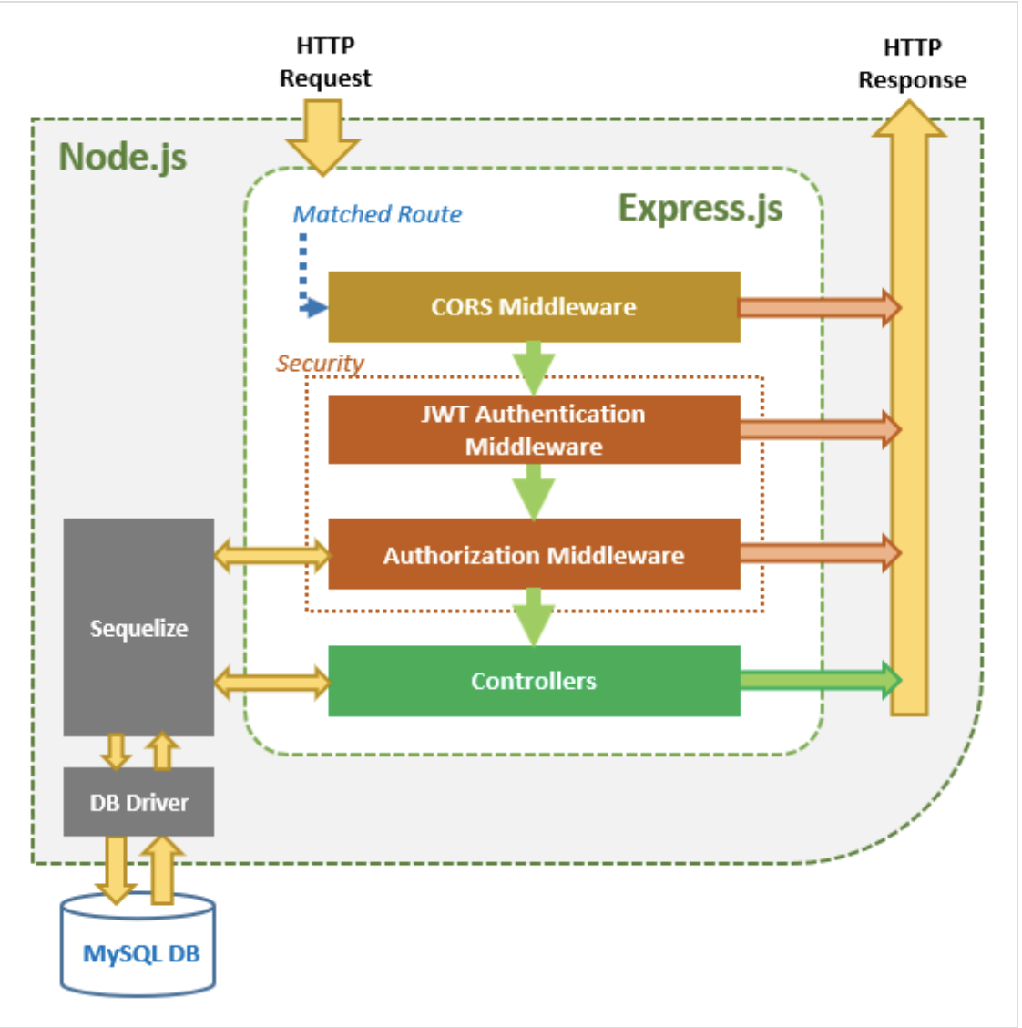
Graduation IN Informatics engineering
3.1 Application Architecture
Project III
@2020/2021 – Luis Alonso 17506– Backend Node.js, Express, MySQL
- 12 -

Slide 13
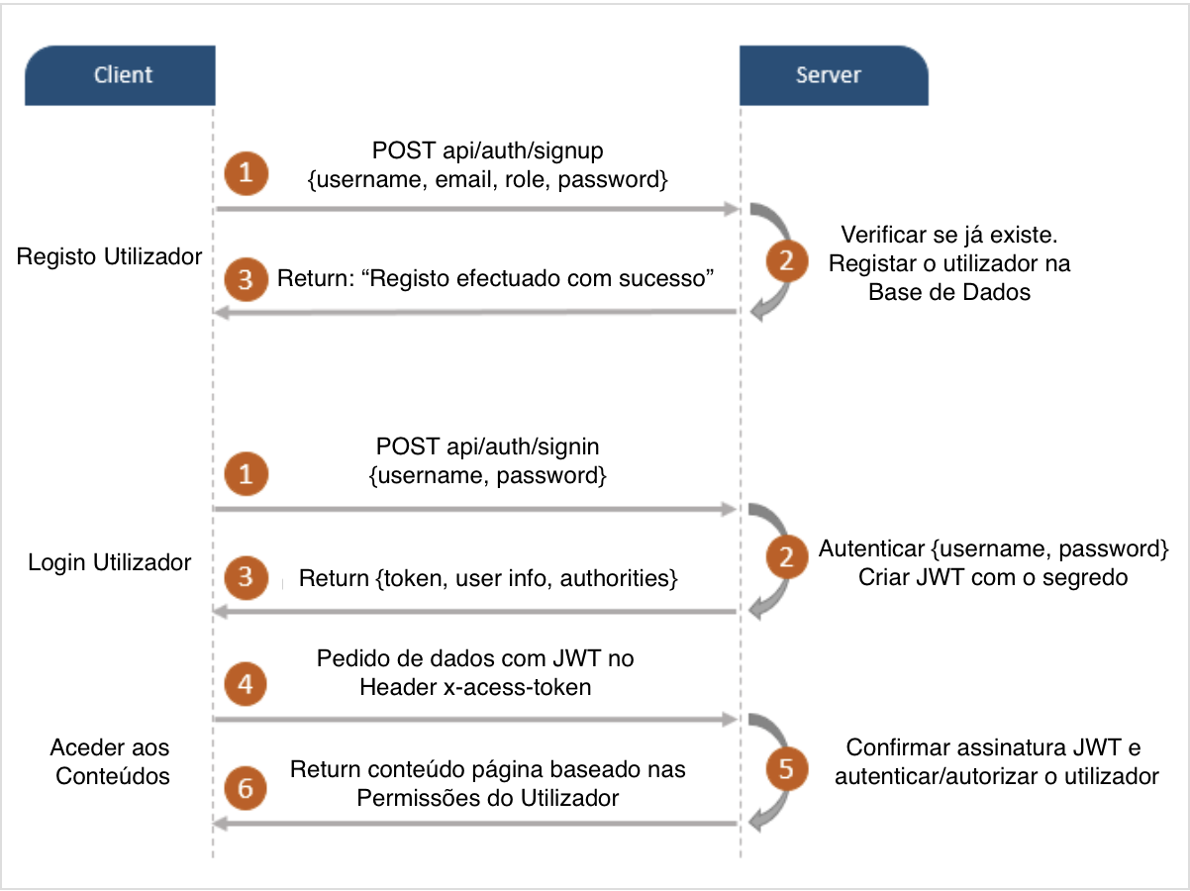
Graduation IN Informatics engineering
3.2 Flow for Signup & Login with JWT Authentication
Project III
@2020/2021 – Luis Alonso 17506– Backend Node.js, Express, MySQL
- 13 -

Slide 14
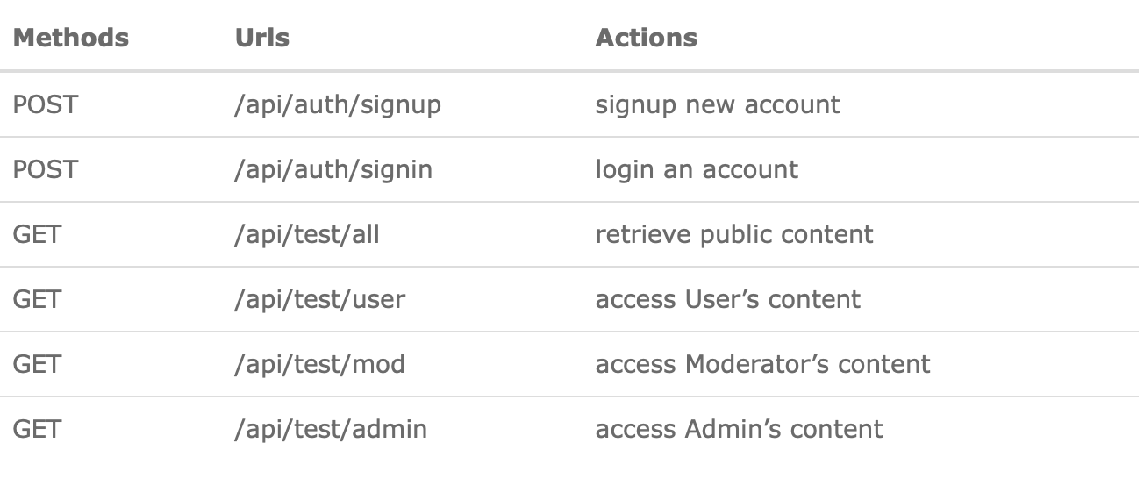
Graduation IN Informatics engineering
3.3 API EndPoints
Project III
@2020/2021 – Luis Alonso 17506– Backend Node.js, Express, MySQL
- 14 -

Slide 15
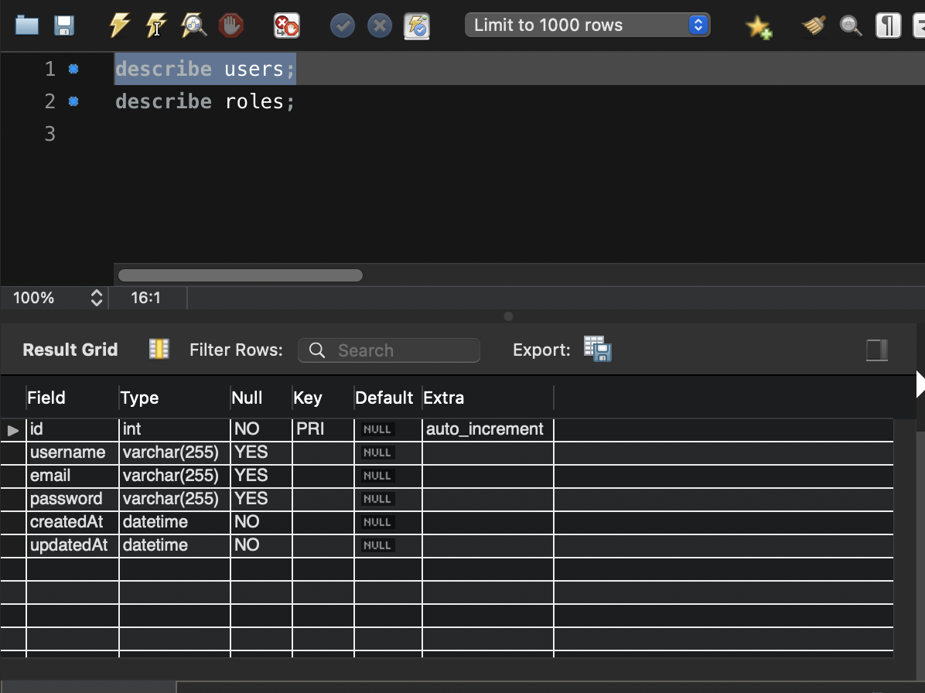
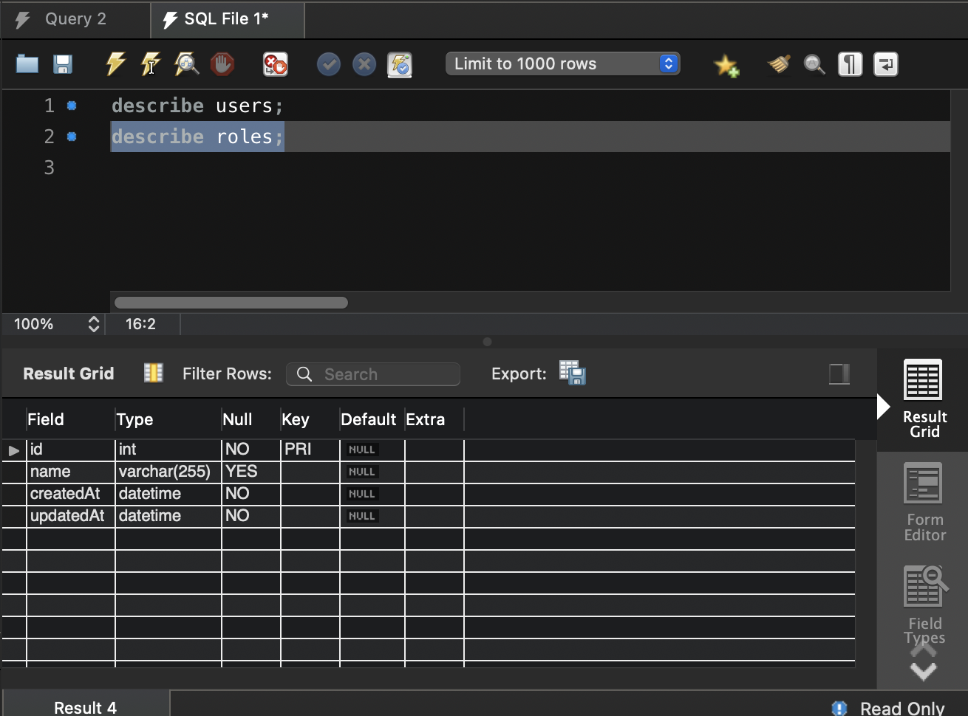
Graduation IN Informatics engineering
3.4 Tables created in the DataBase
Project III
@2020/2021 – Luis Alonso 17506– Backend Node.js, Express, MySQL
- 15 -

Slide 16
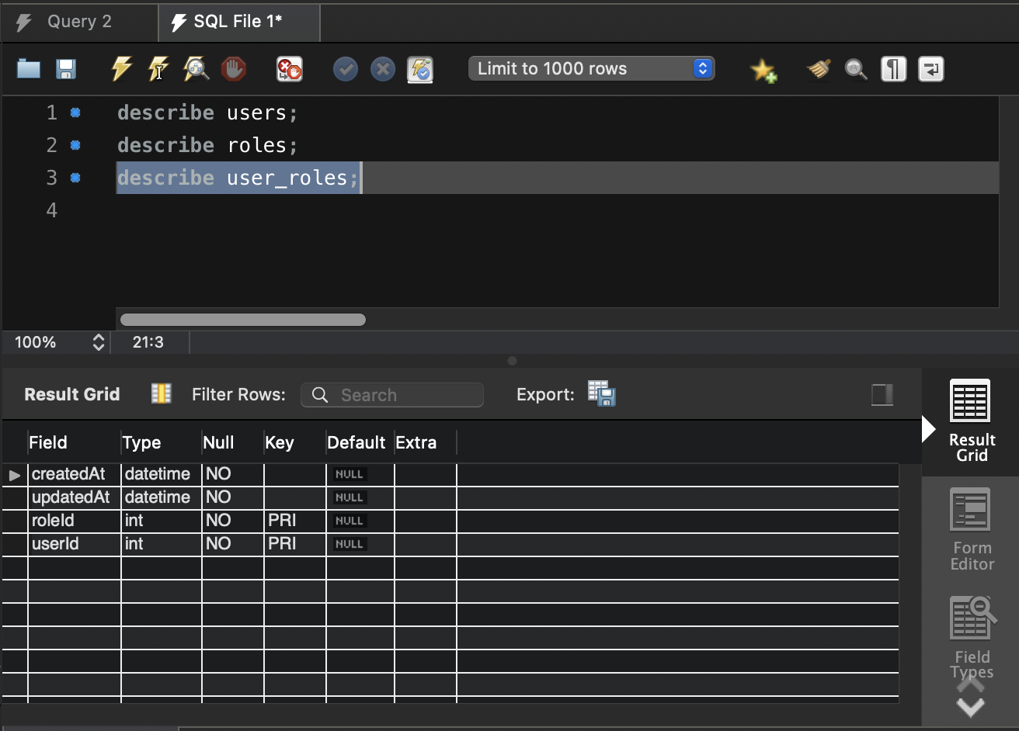
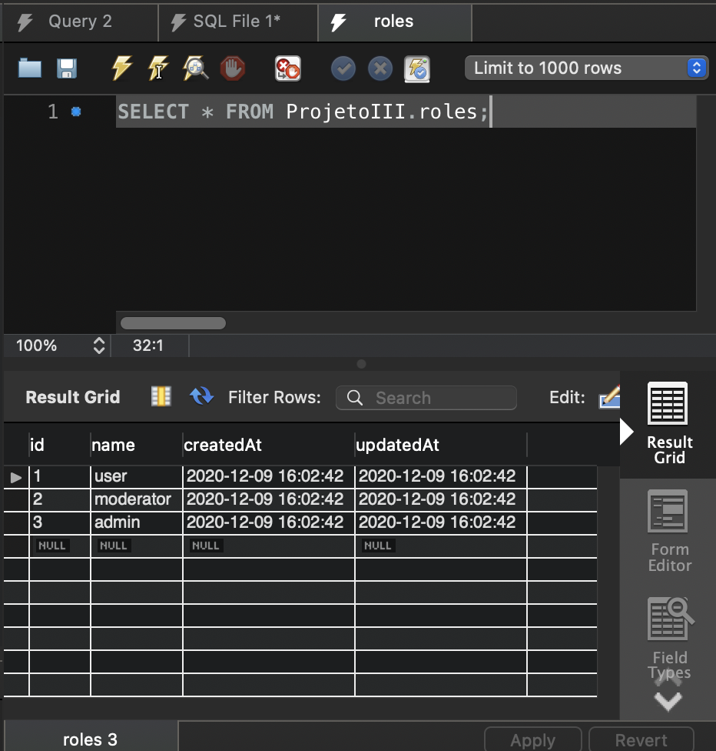
Graduation IN Informatics engineering
3.4 Tables created in the DataBase
Project III
@2020/2021 – Luis Alonso 17506– Backend Node.js, Express, MySQL
- 16 -

Slide 17
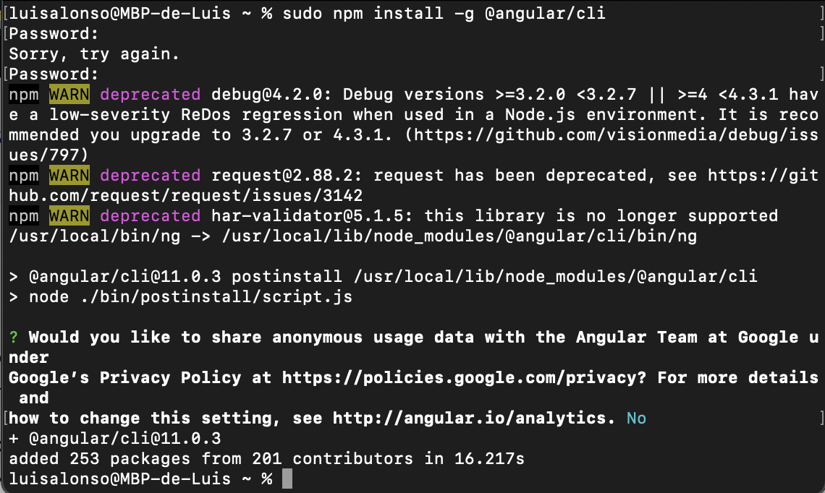
Graduation IN Informatics engineering
4. Implementation
Project III
Angular / Node Installation
@2020/2021 – Luis Alonso 17506– Backend Node.js, Express, MySQL
- 17 -

Slide 18
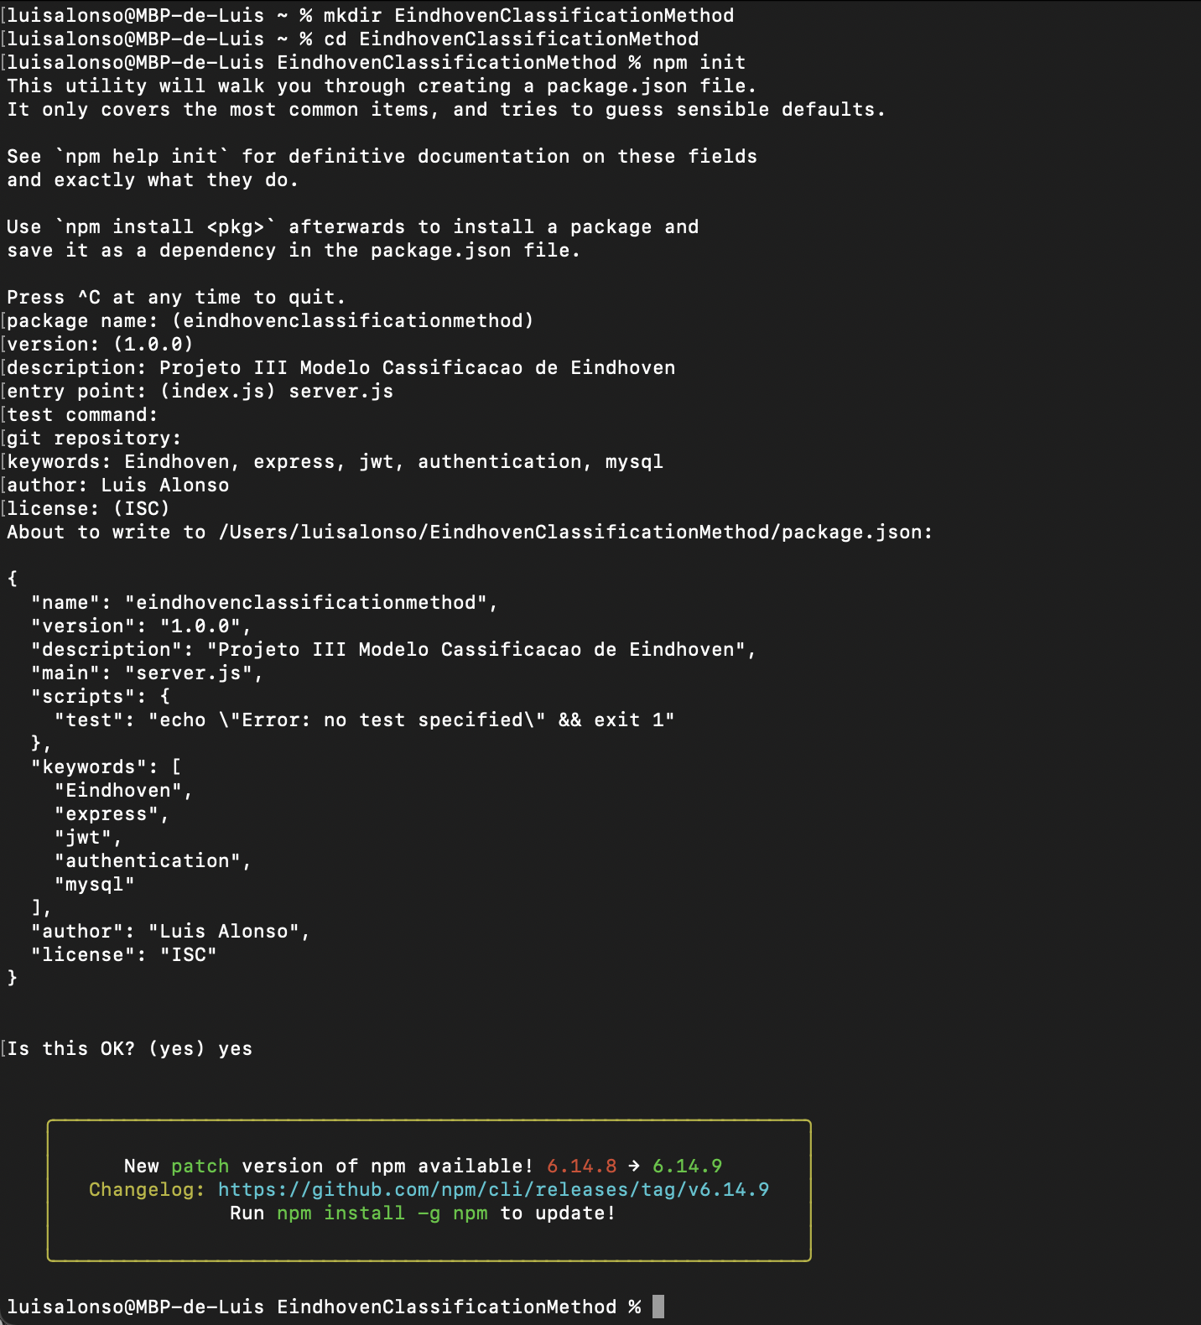
Graduation IN Informatics engineering
4. Implementation
Project III
Creating the Project called “Eindhoven Classification Method”
@2020/2021 – Luis Alonso 17506– Backend Node.js, Express, MySQL
- 18 -

Slide 19
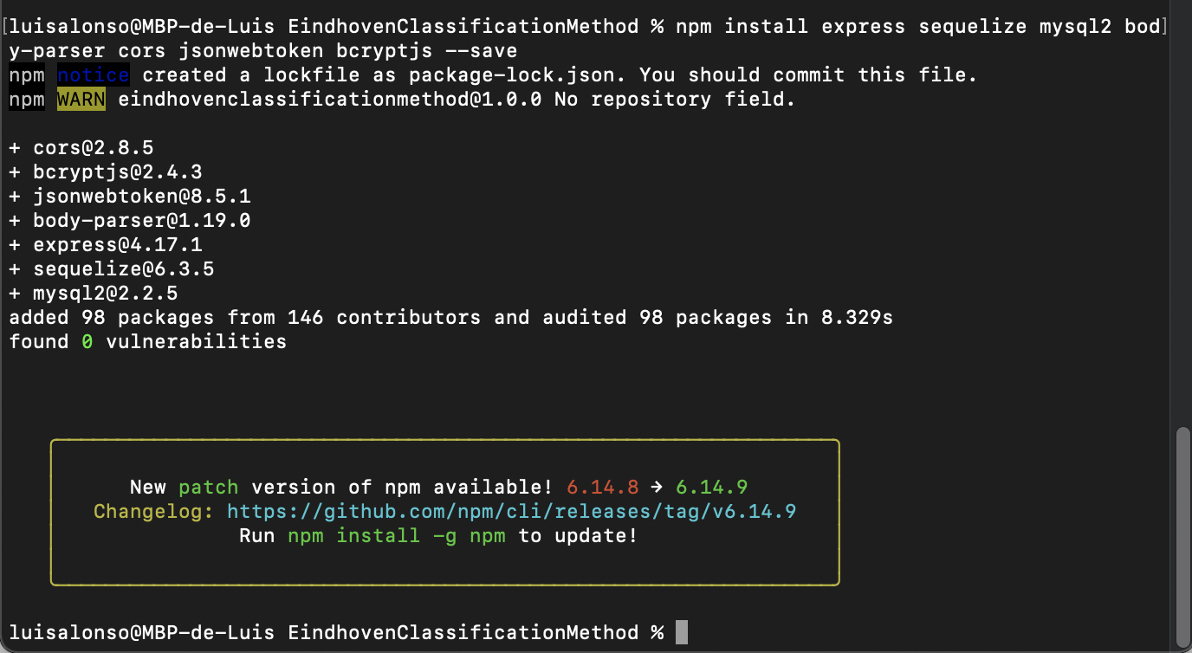
Graduation IN Informatics engineering
4. Implementation
Project III
Installation of the necessary modules
@2020/2021 – Luis Alonso 17506– Backend Node.js, Express, MySQL
- 19 -

Slide 20
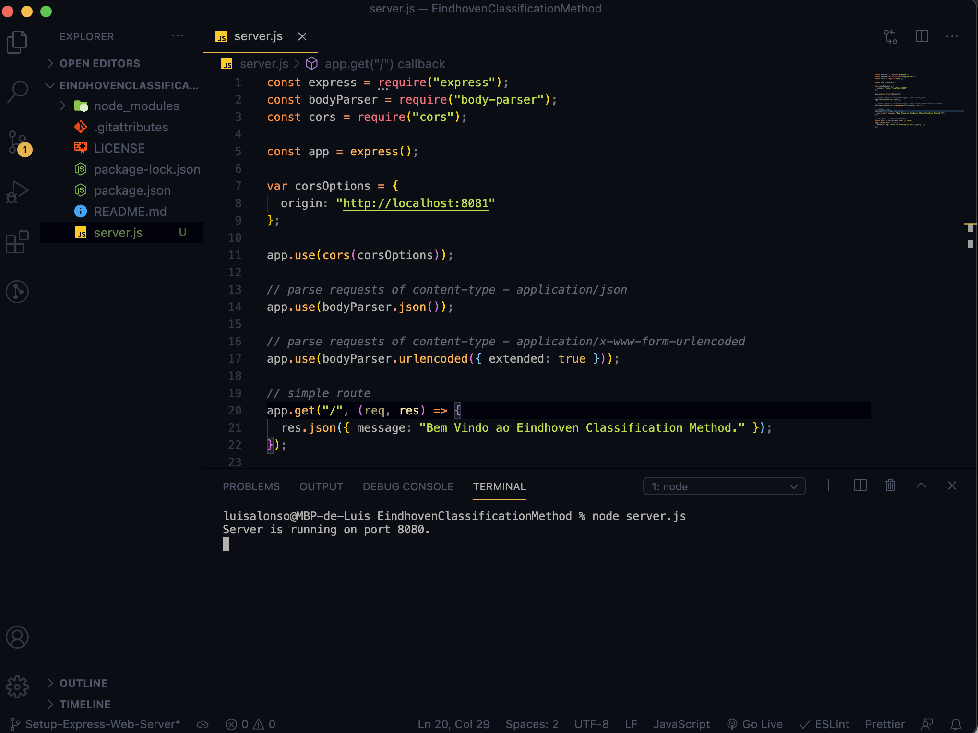
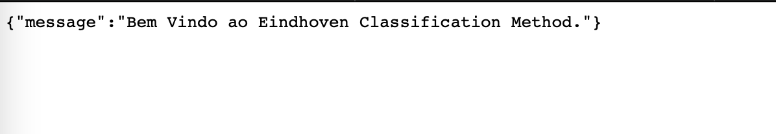
Graduation IN Informatics engineering
4. Implementation
Project III
Setup of Express.
@2020/2021 – Luis Alonso 17506– Backend Node.js, Express, MySQL
- 20 -

Slide 21
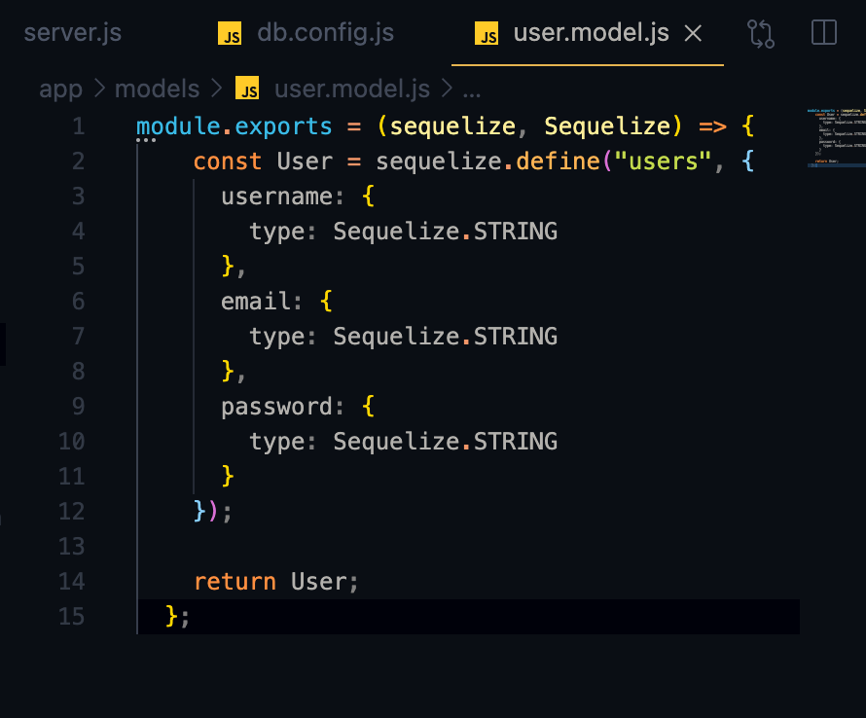
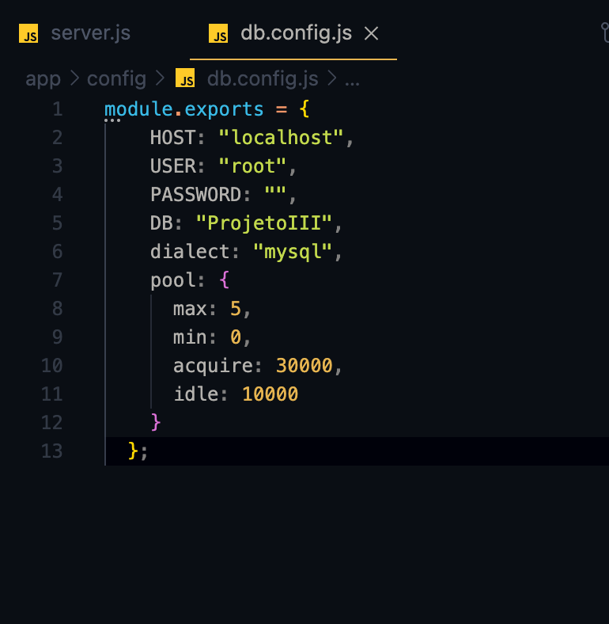
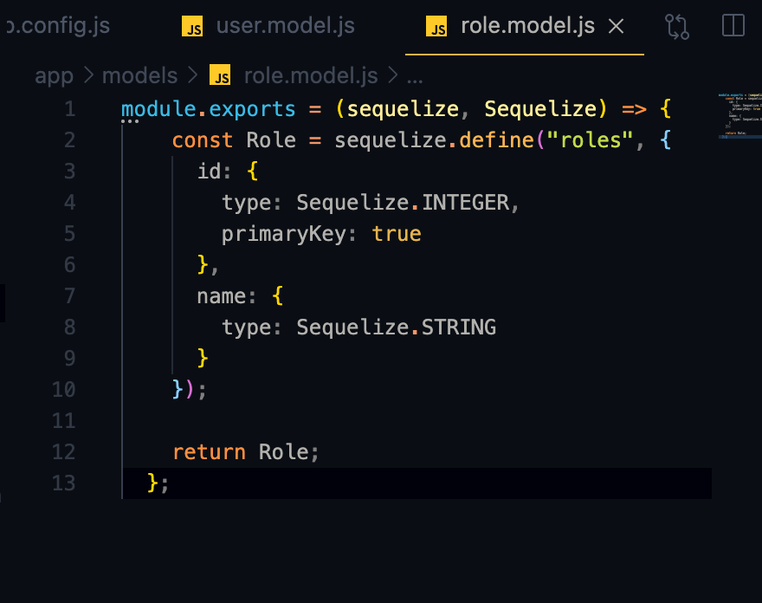
Graduation IN Informatics engineering
4. Implementation
Project III
Configuring MySQL and Sequelize
@2020/2021 – Luis Alonso 17506– Backend Node.js, Express, MySQL
- 21 -

Slide 22
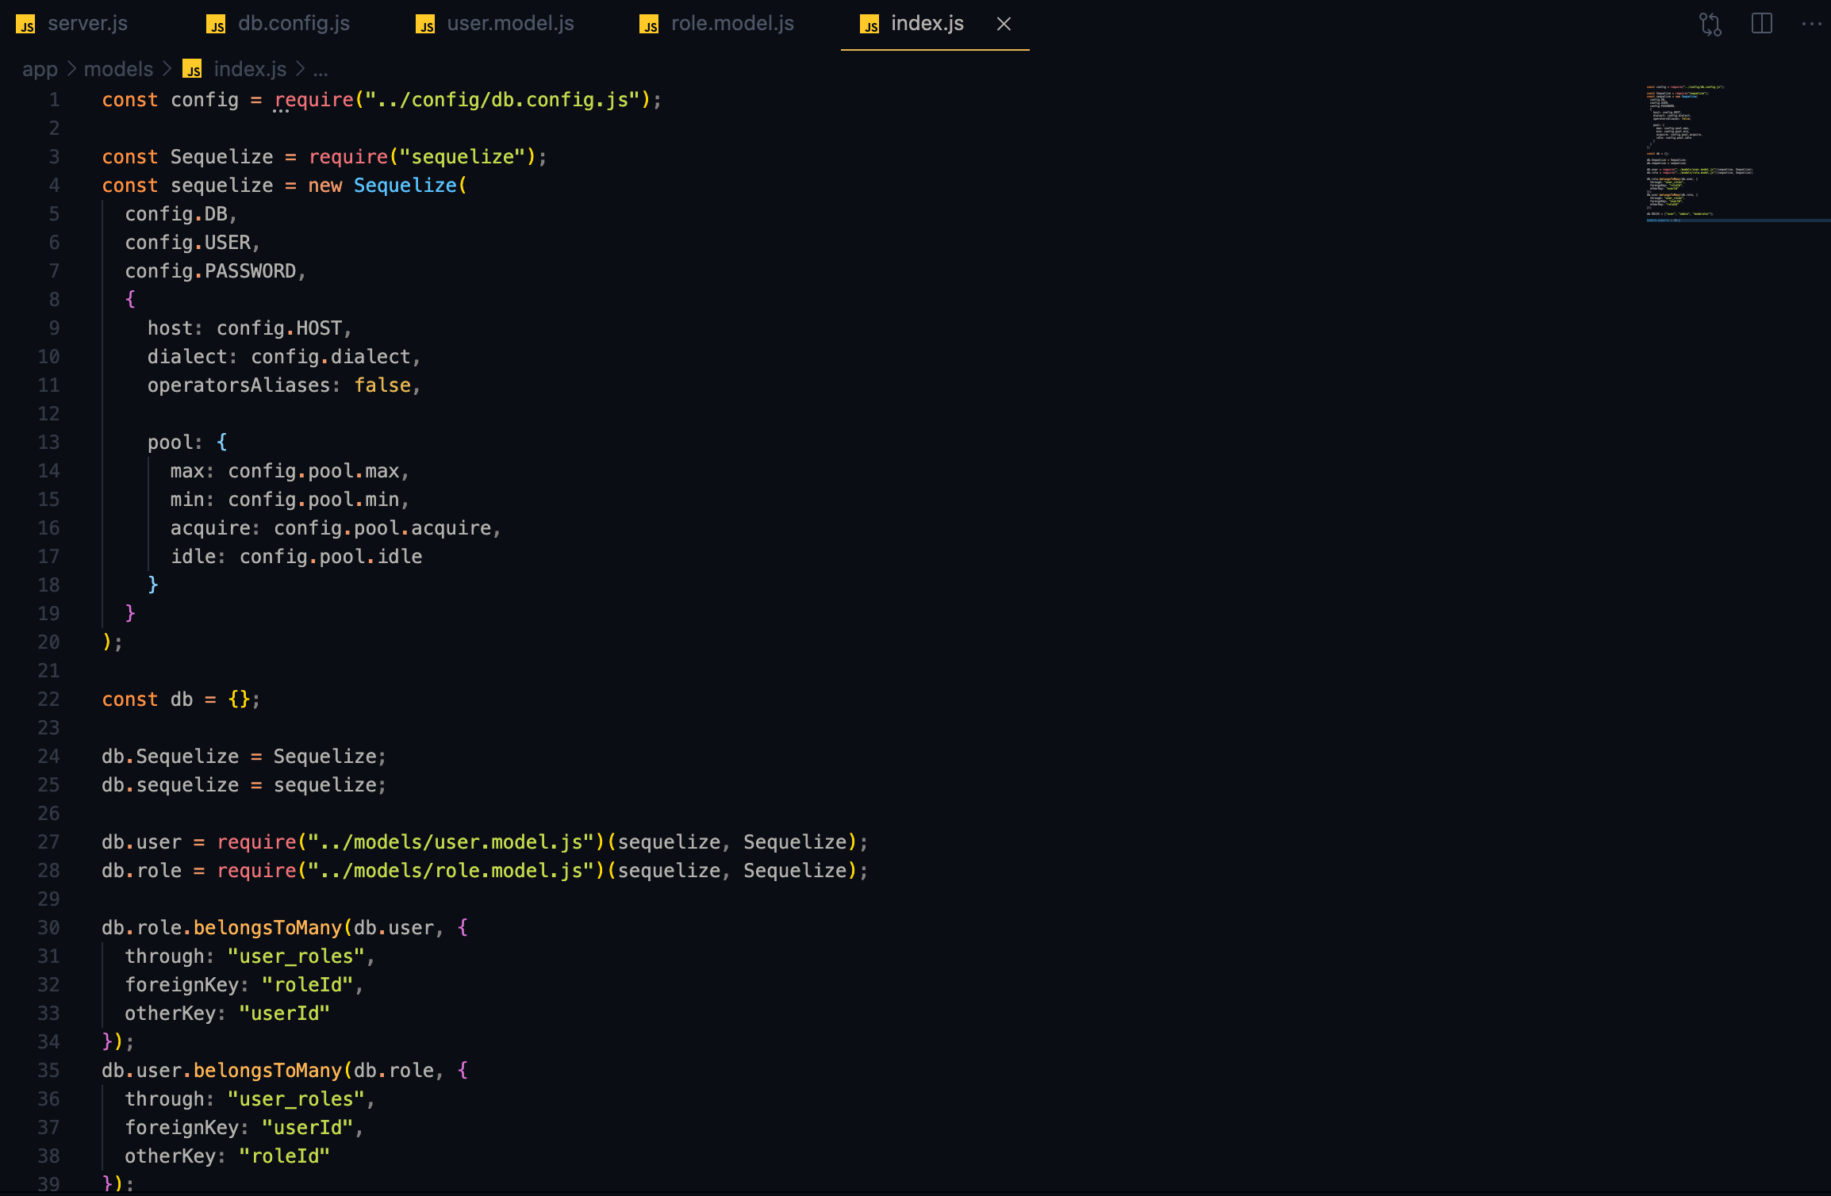
Graduation IN Informatics engineering
4. Implementation
Project III
Sync() Sequelize on Index.js
@2020/2021 – Luis Alonso 17506– Backend Node.js, Express, MySQL
- 22 -

Slide 23
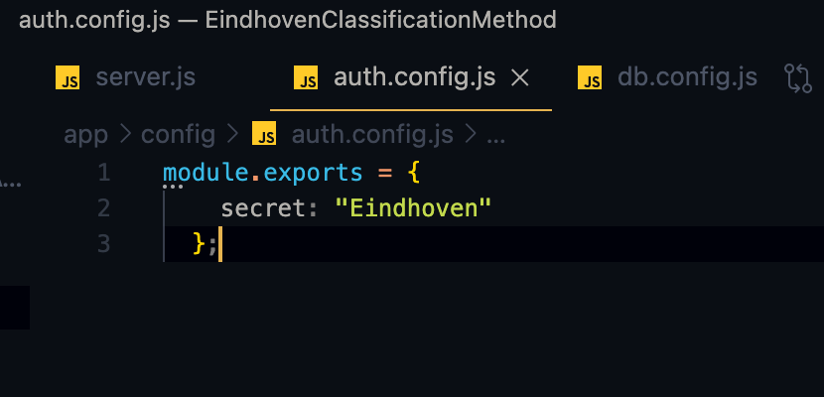
Graduation IN Informatics engineering
4. Implementation
Project III
Creating the secret for the functions: verify() / sign() of JsonWebToken.
The secret is, as previously stated, “Eindhoven”.
@2020/2021 – Luis Alonso 17506– Backend Node.js, Express, MySQL
- 23 -

Slide 24
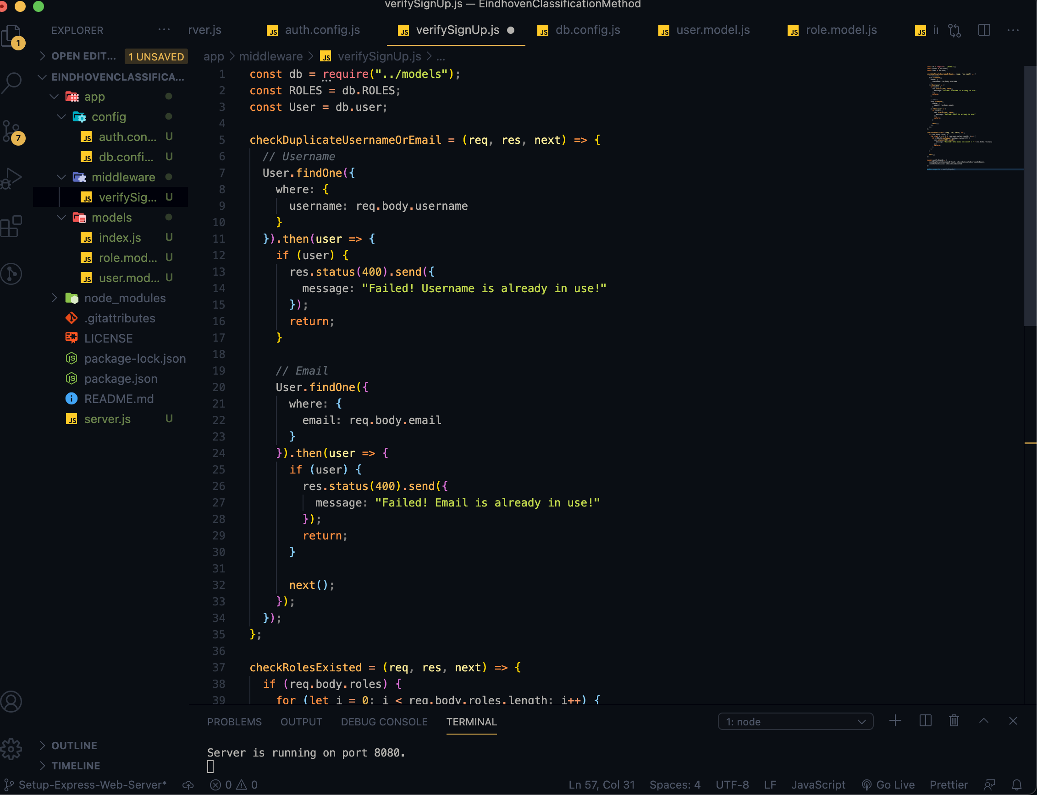
Graduation IN Informatics engineering
4. Implementation
Project III
Functions to verify SignUp (Checking there are no duplicates and checking if the Role exists.)
@2020/2021 – Luis Alonso 17506– Backend Node.js, Express, MySQL
- 24 -

Slide 25
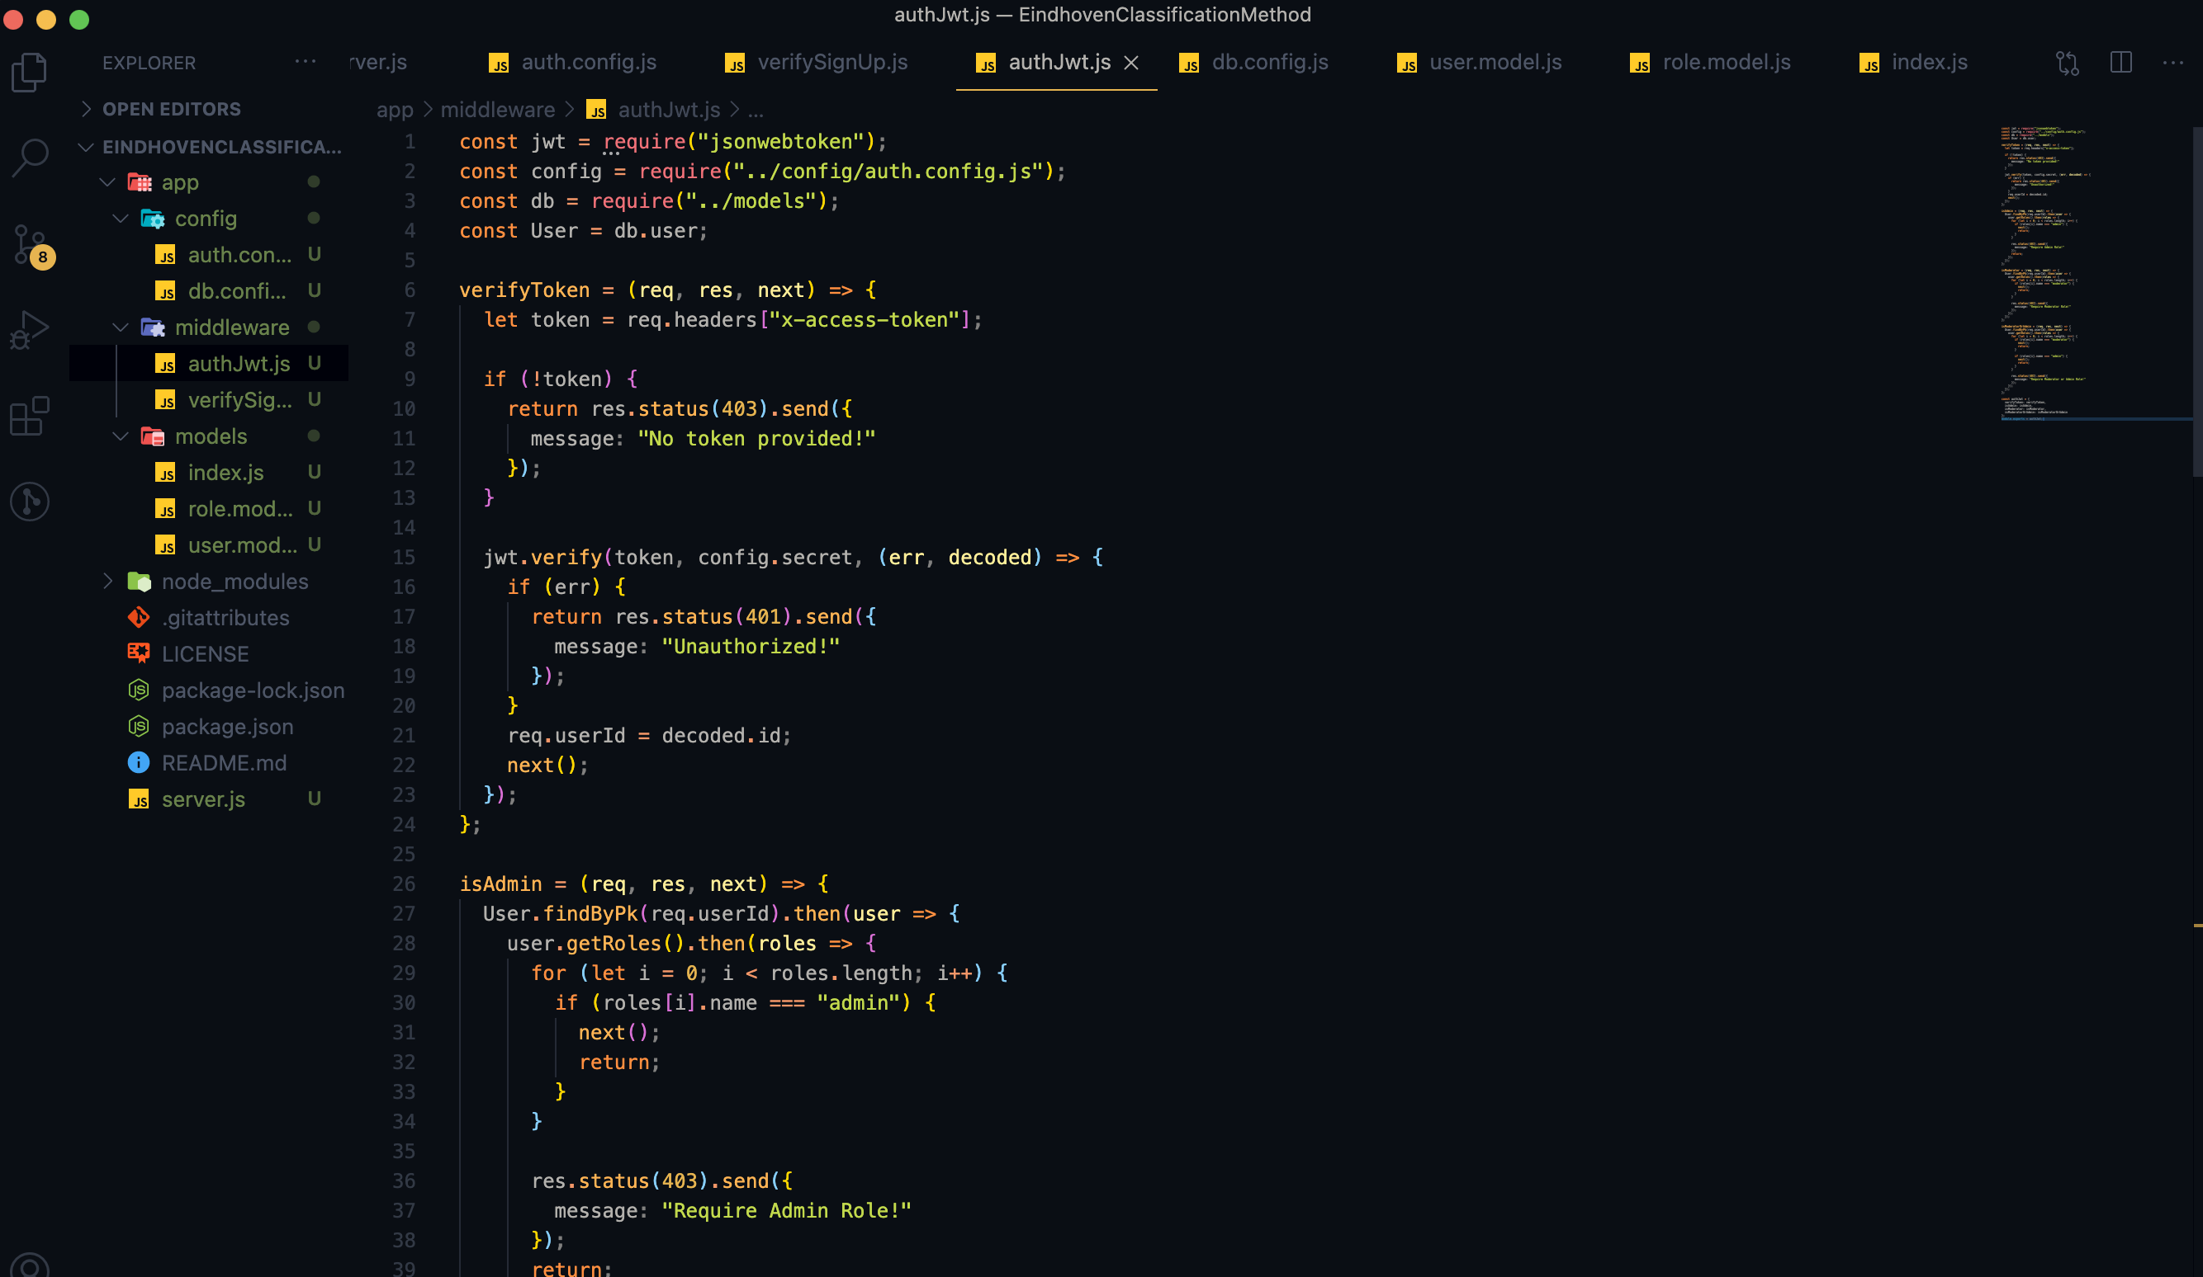
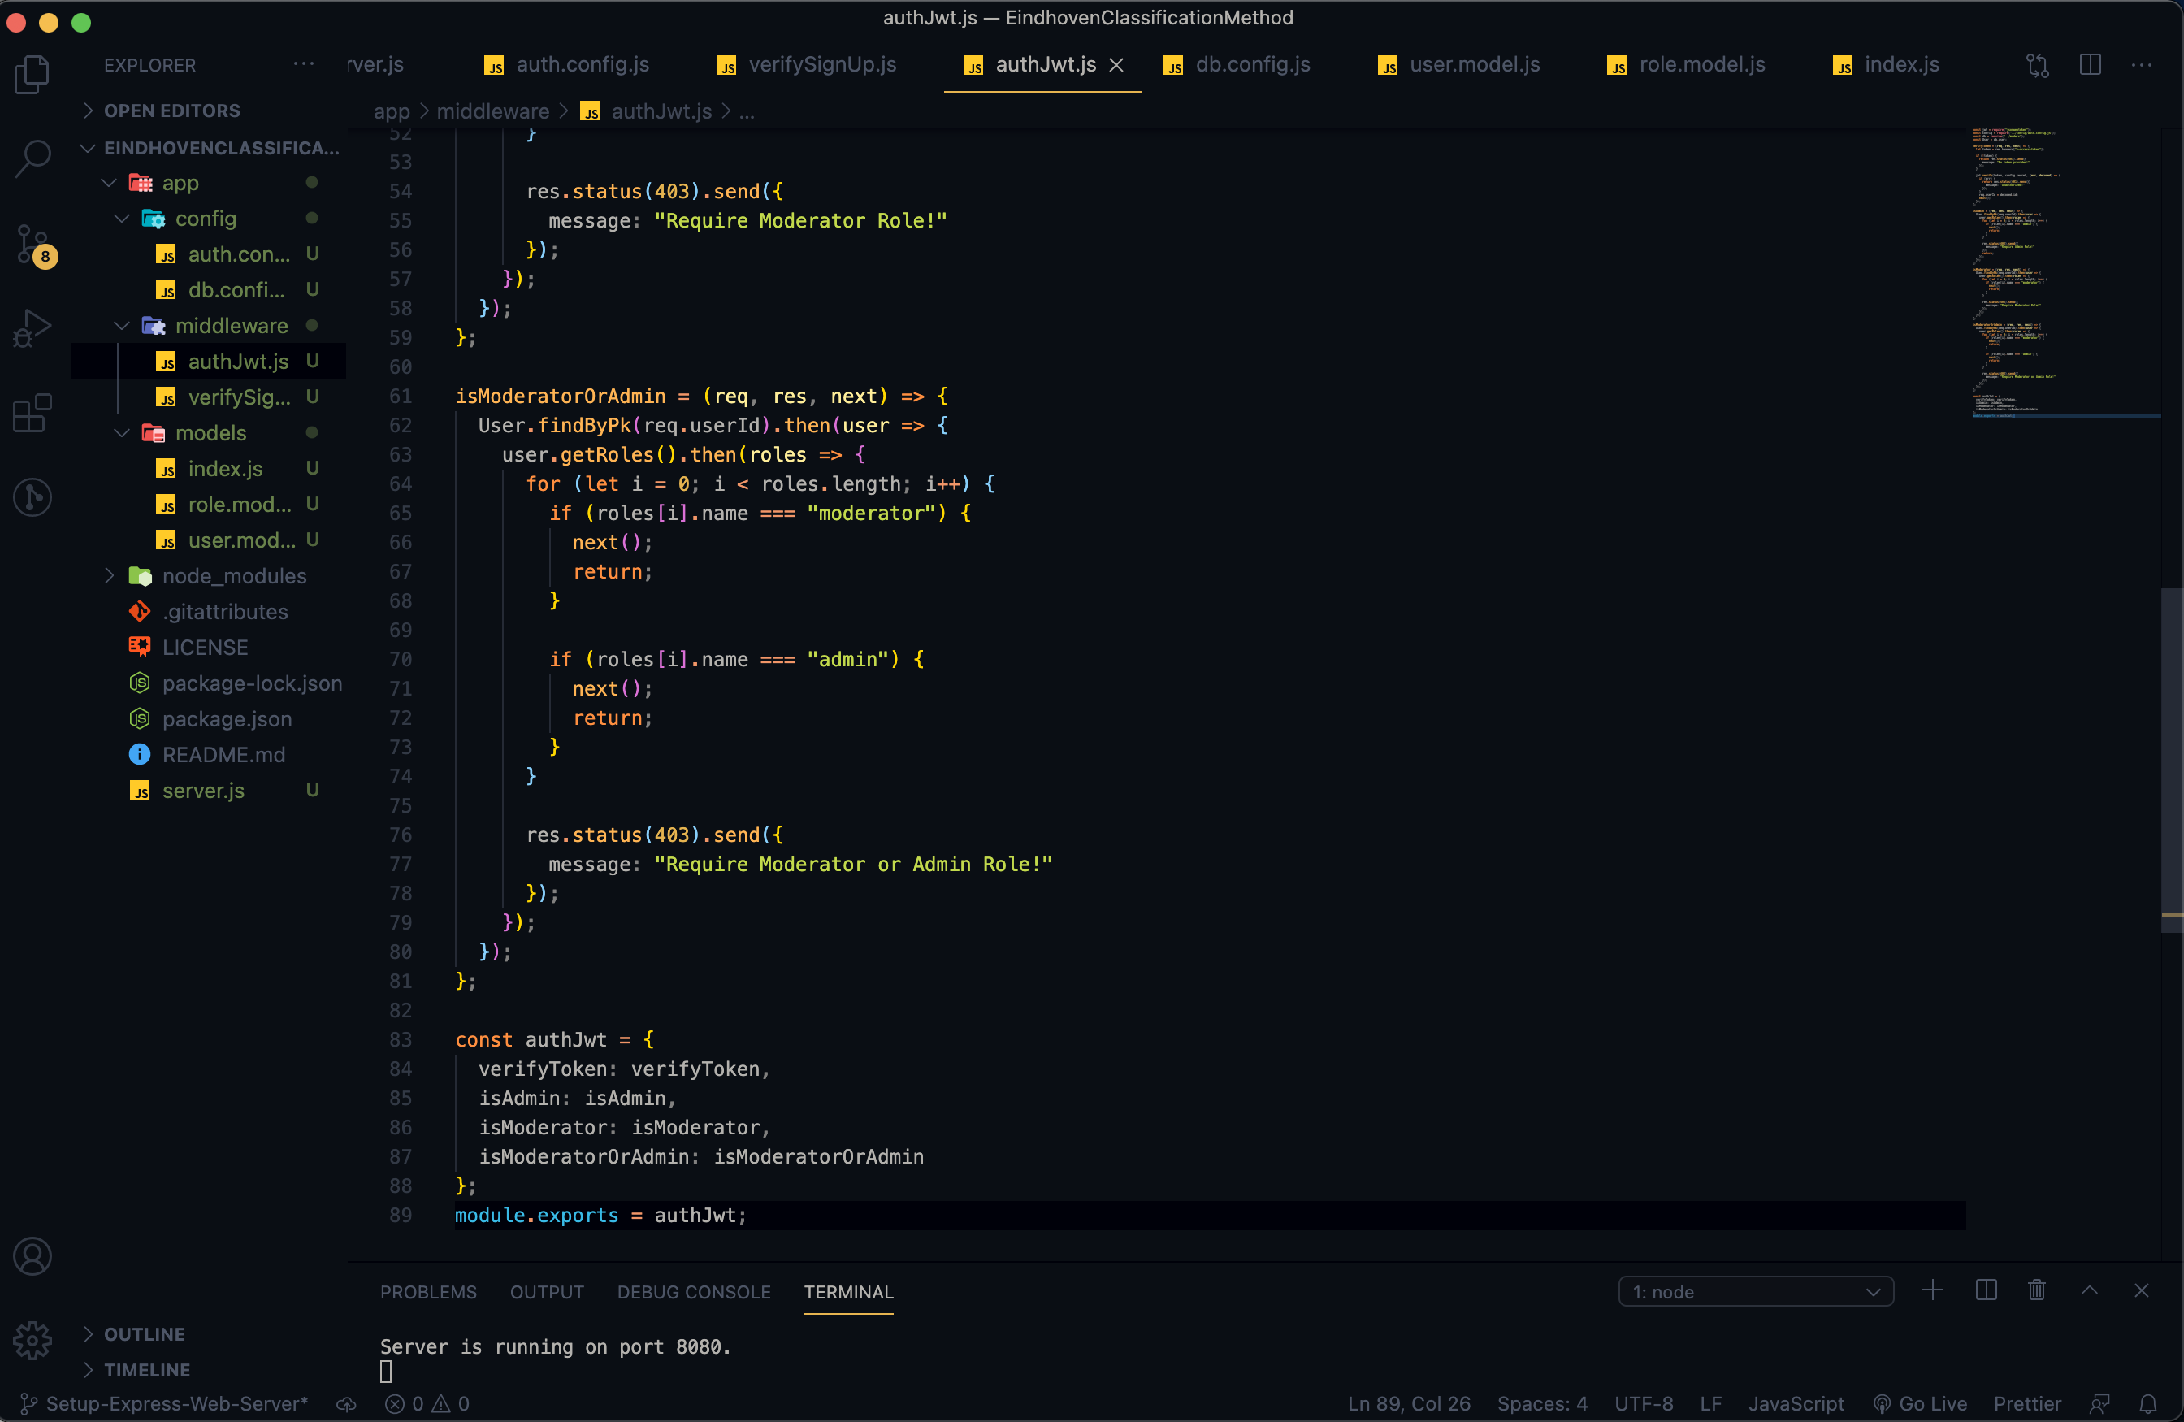
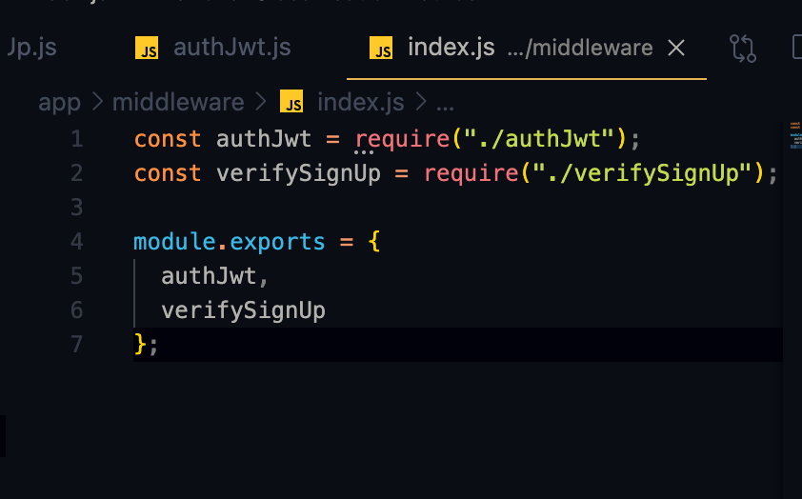
Graduation IN Informatics engineering
■ 4. Implementation
Project III
Verify the Token (if it is provided/ legal or not), through the function verify().
@2020/2021 – Luis Alonso 17506– Backend Node.js, Express, MySQL
- 25 -

Slide 26
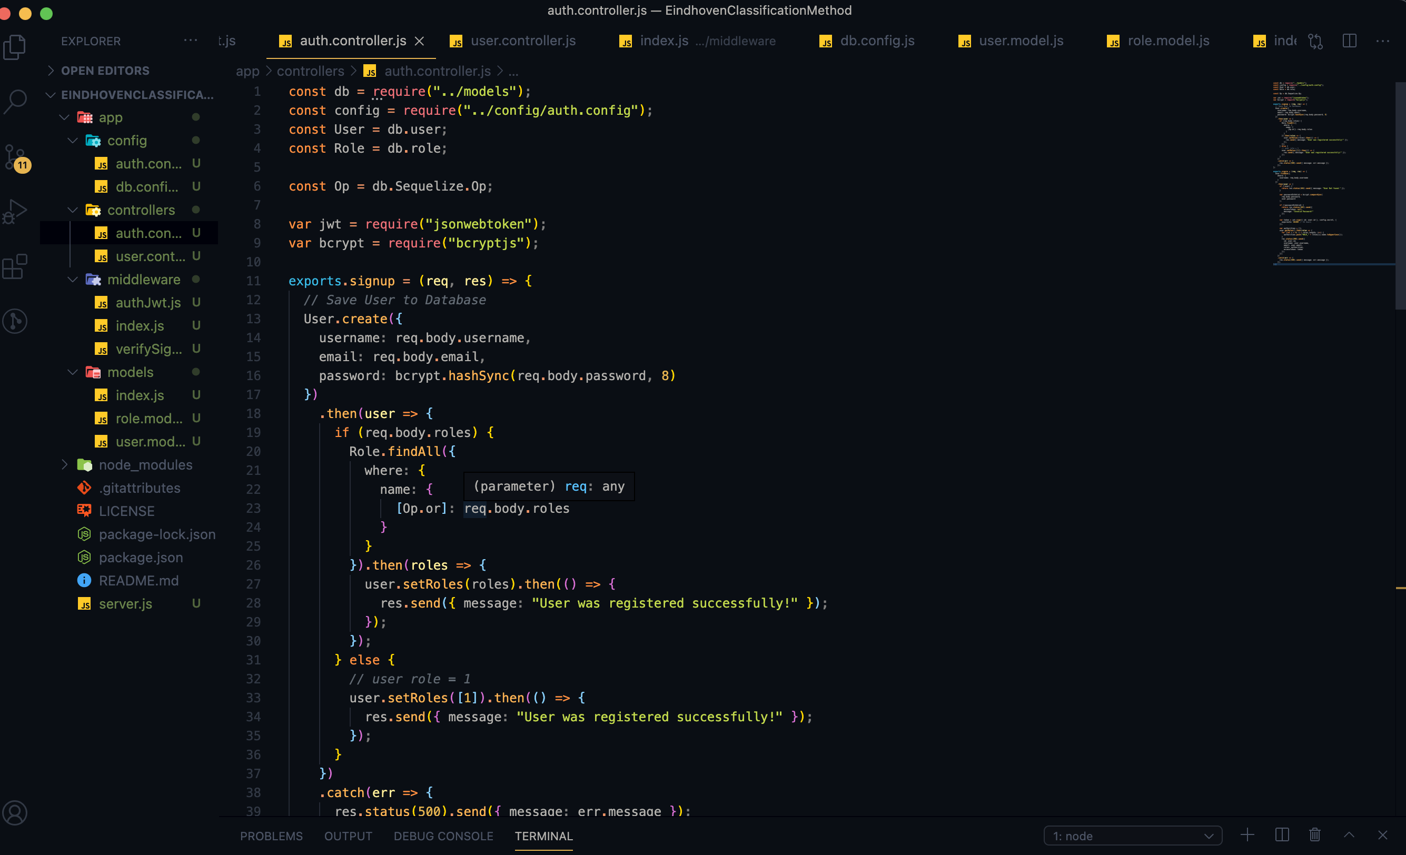
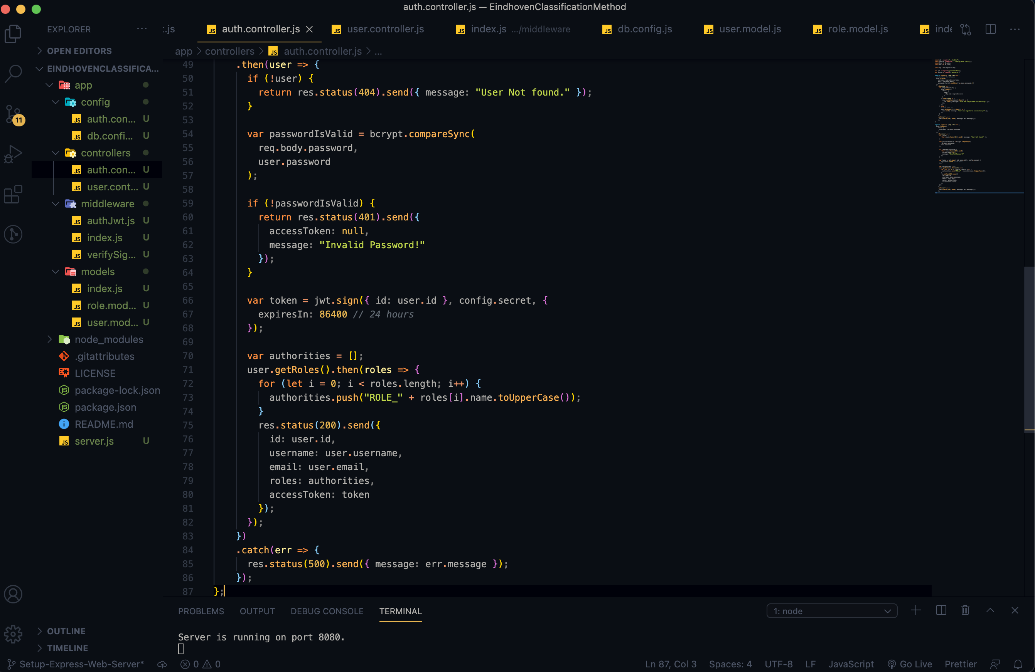
Graduation IN Informatics engineering
4. Implementation
Project III
Creating Authentication Controllers
@2020/2021 – Luis Alonso 17506– Backend Node.js, Express, MySQL
- 26 -

Slide 27
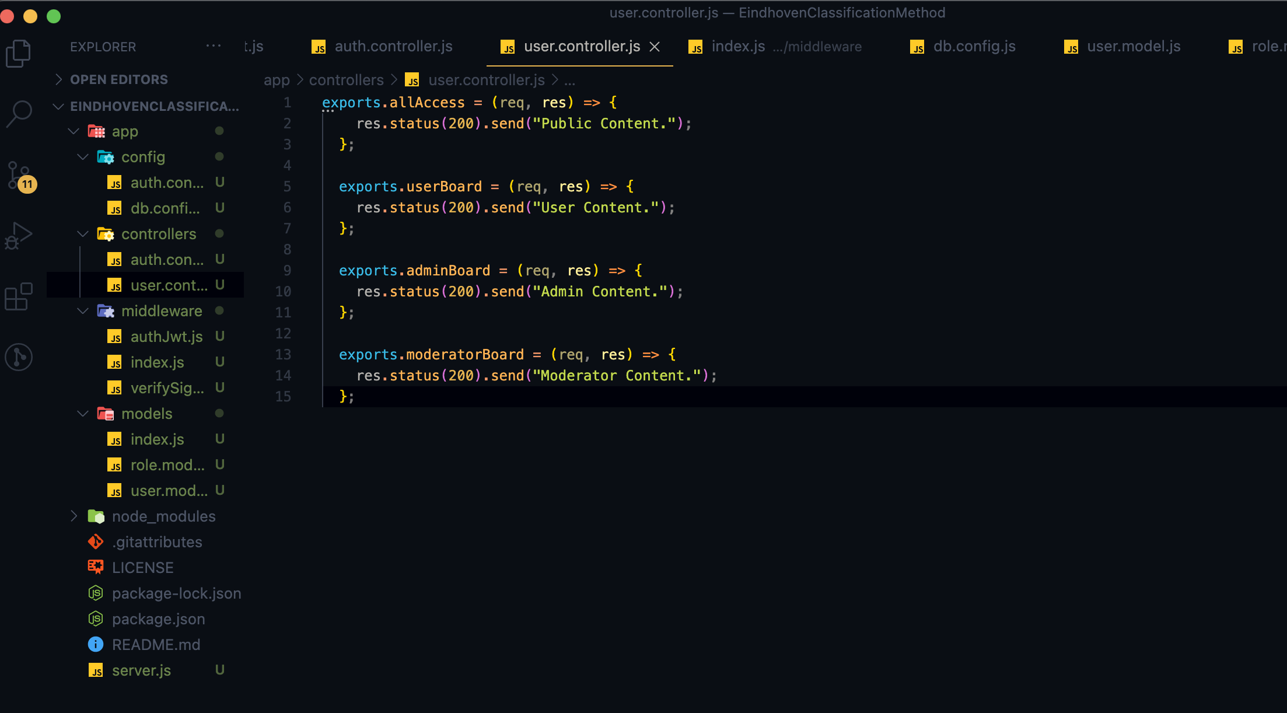
Graduation IN Informatics engineering
4. Implementation
Project III
Controller to test permissions.
/api/test/all
/api/test/user
/api/test/mod
/api/test/admin
@2020/2021 – Luis Alonso 17506– Backend Node.js, Express, MySQL
- 27 -

Slide 28
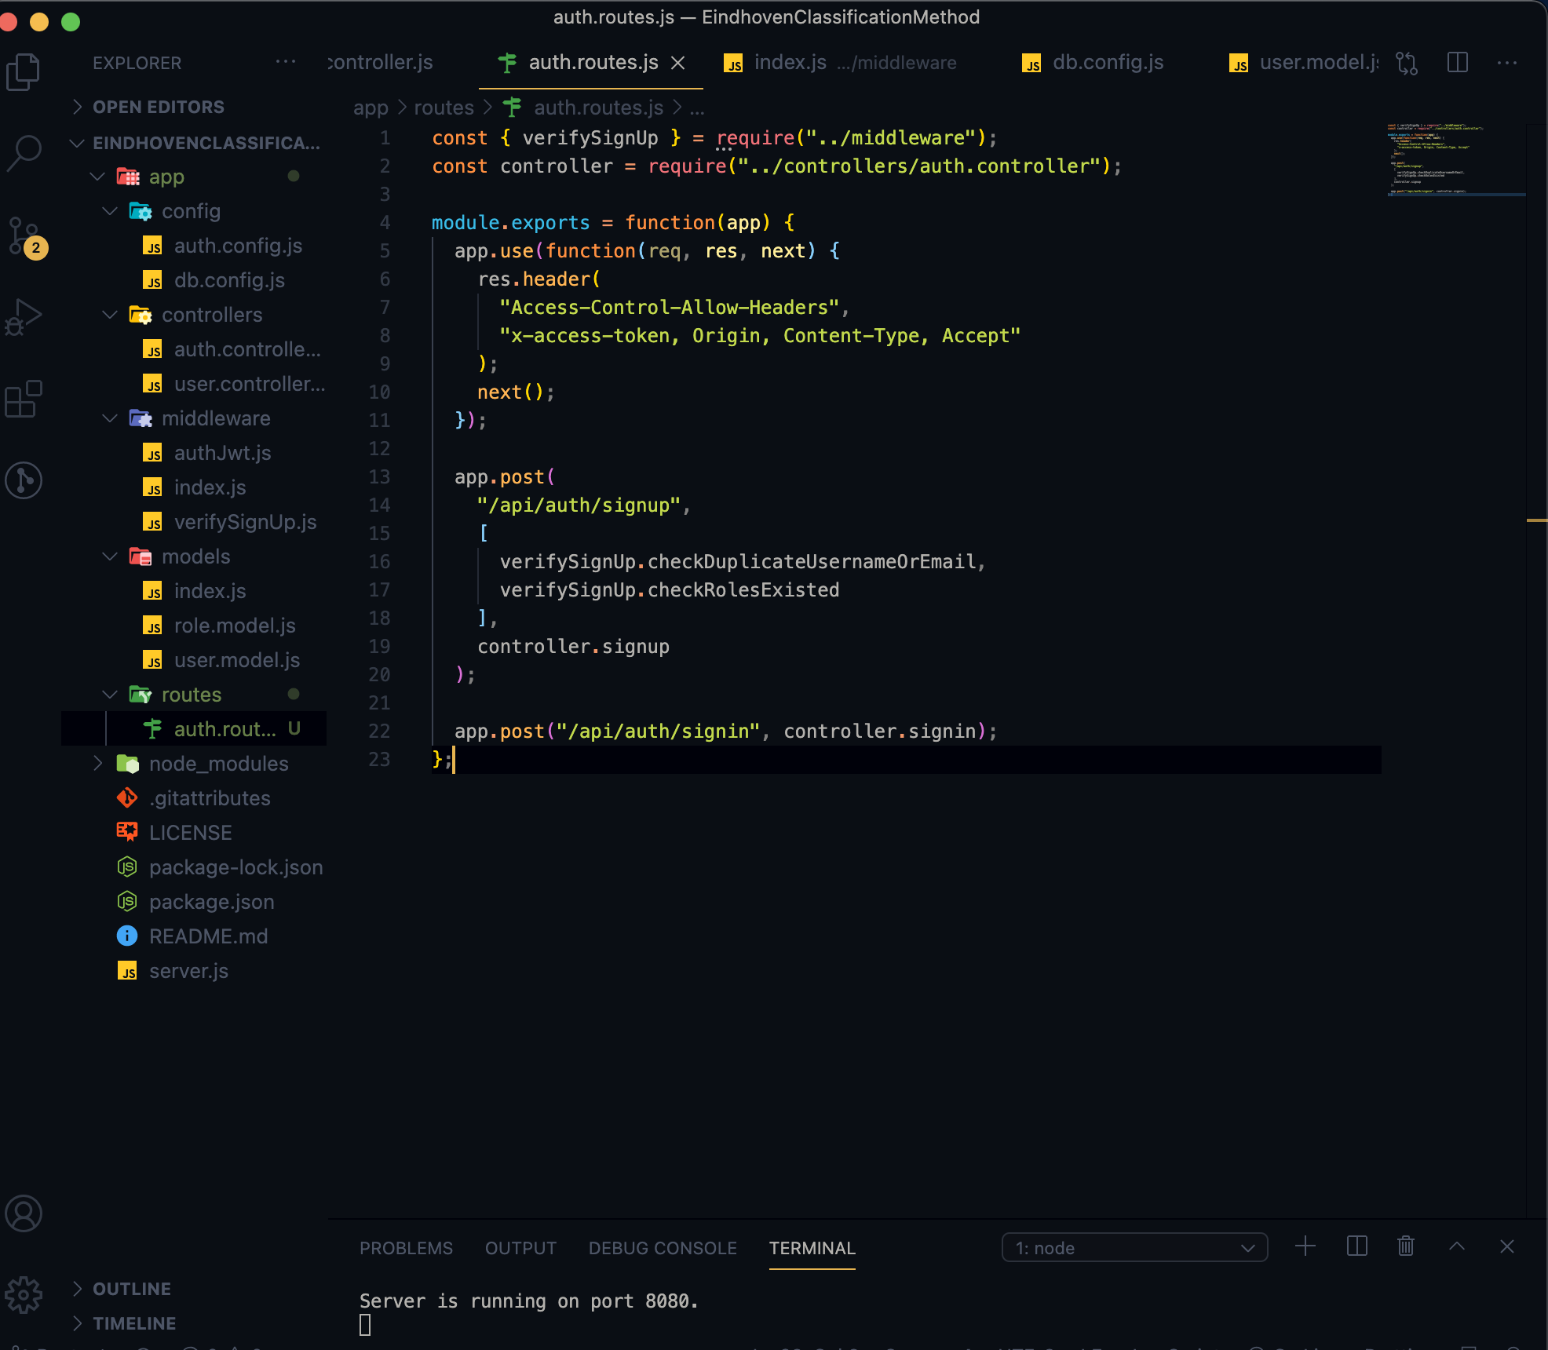
Graduation IN Informatics engineering
4. Implementation
Project III
When a client sends request for an endpoint using HTTP request (GET, POST, PUT, DELETE), we need to determine how the server will respond by setting up the routes.
We can separate our routes into 2 parts: Authentication and Authorization
Authentication
POST /api/auth/signup POST /apu/auth/signin
@2020/2021 – Luis Alonso 17506– Backend Node.js, Express, MySQL
- 28 -

Slide 29
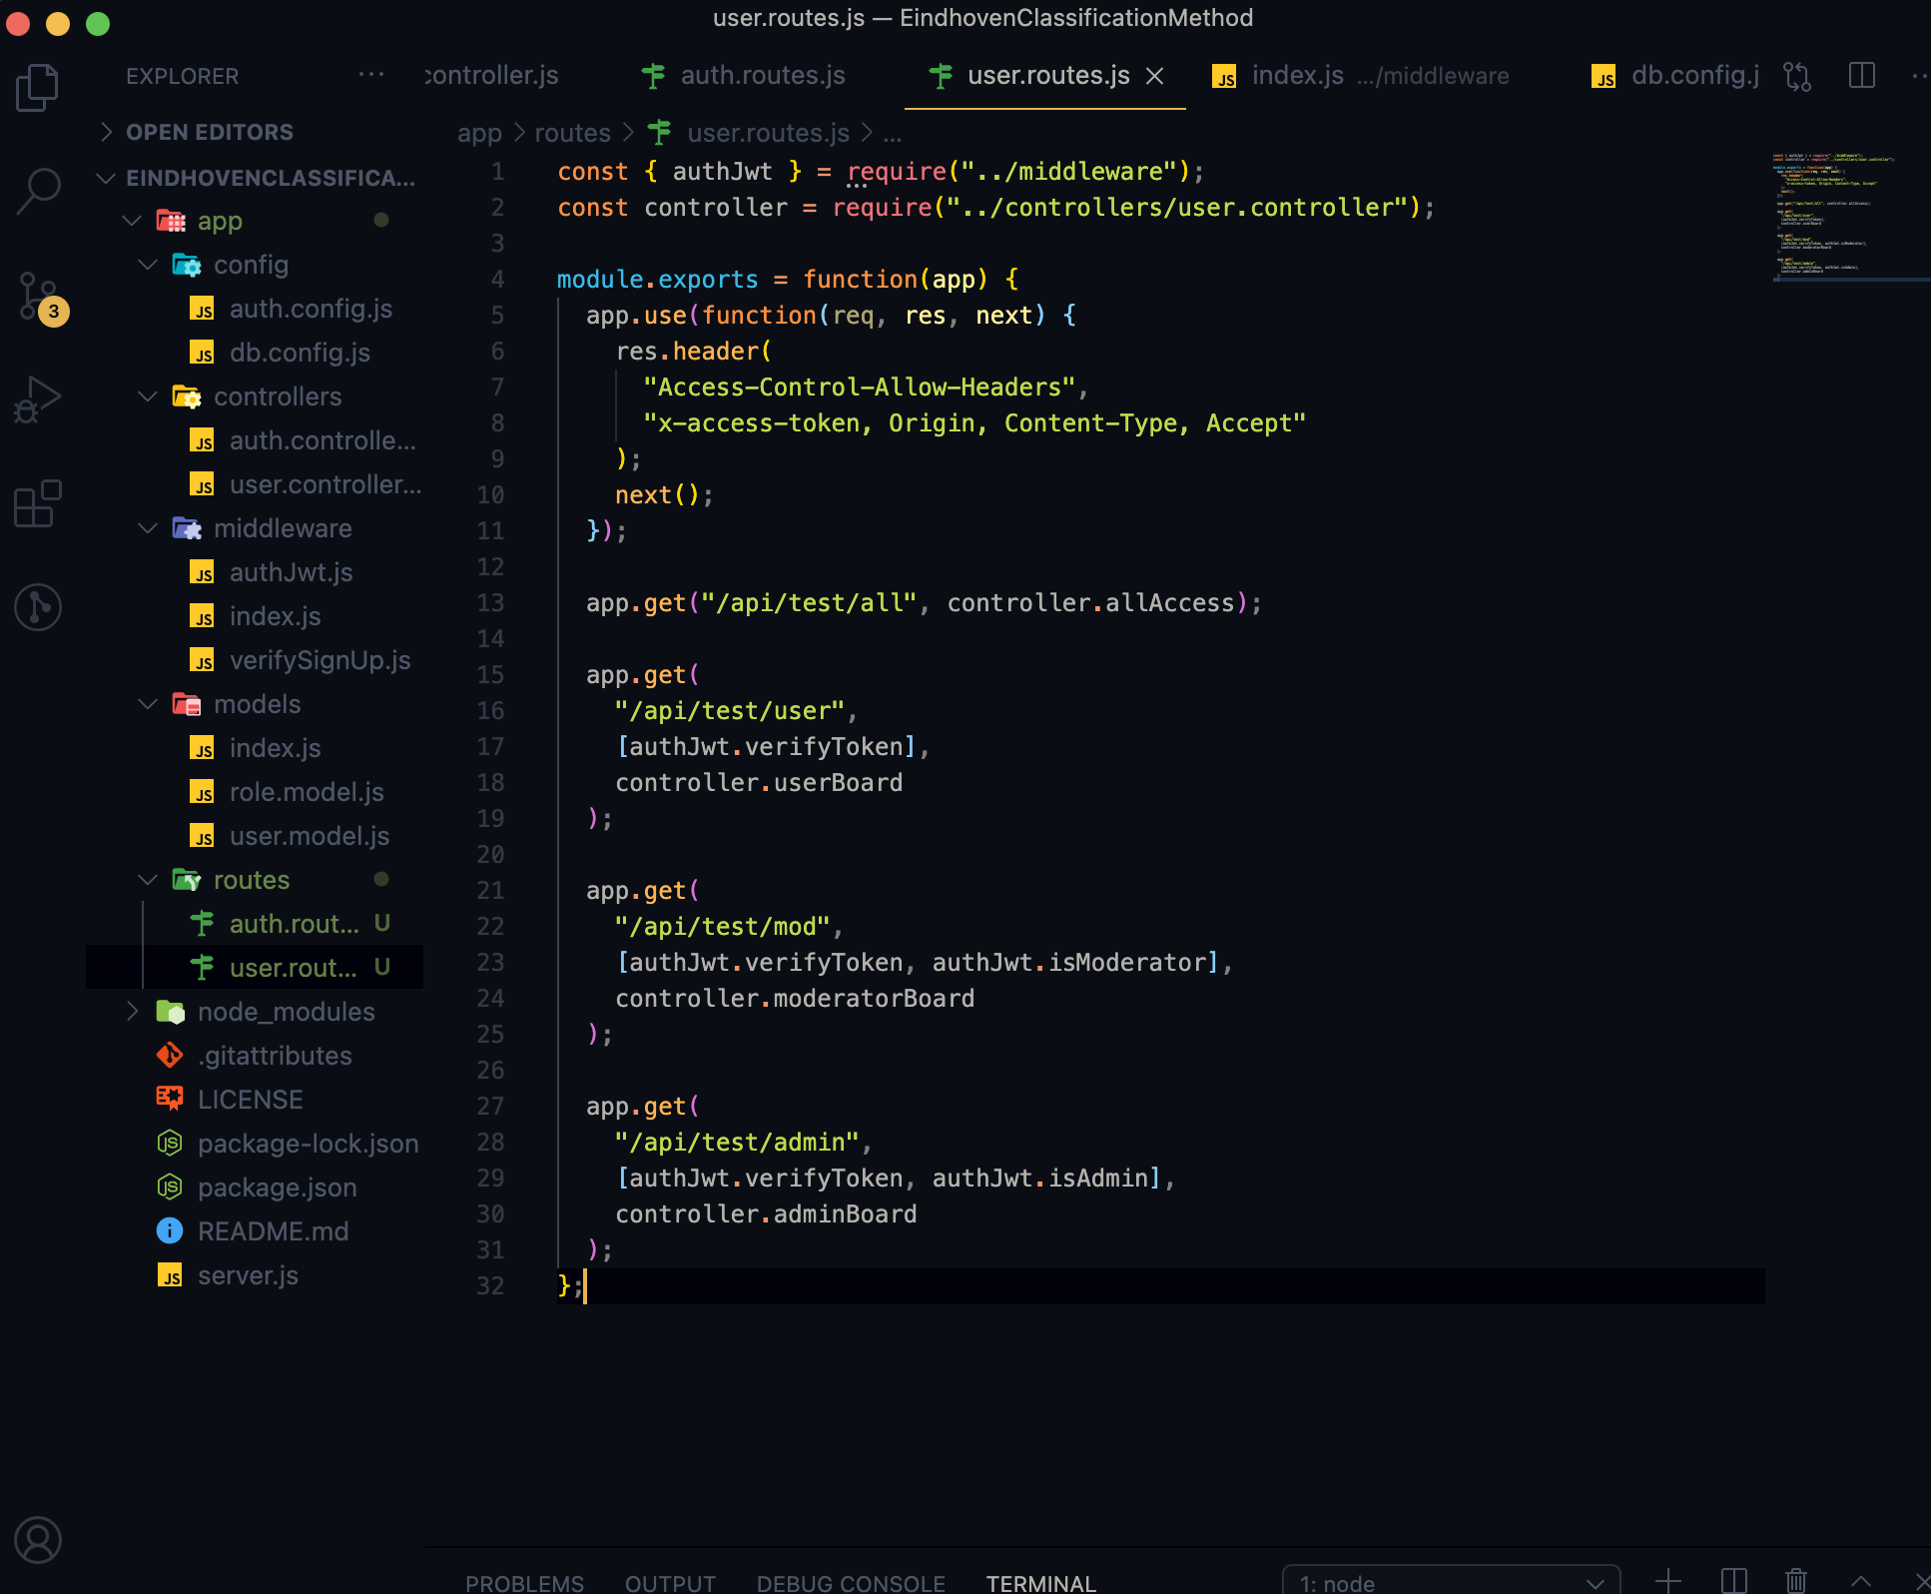
Graduation IN Informatics engineering
4. Implementation
Project III
Authorization
GET /api/test/all
GET /api/test/user
GET /api/test/mod
GET /api/test/admin
@2020/2021 – Luis Alonso 17506– Backend Node.js, Express, MySQL
- 29 -

Slide 30
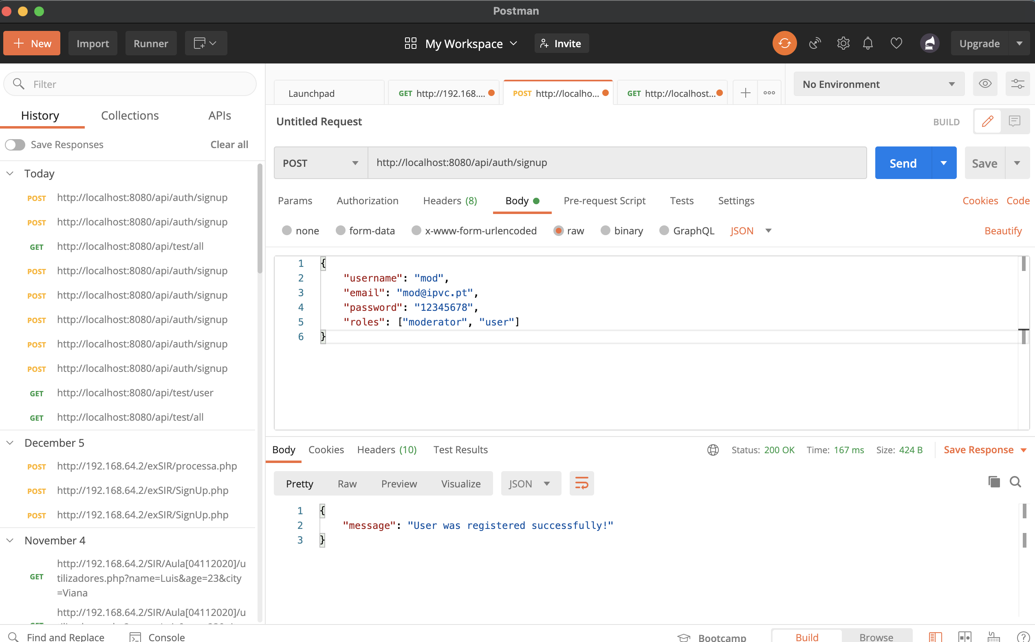
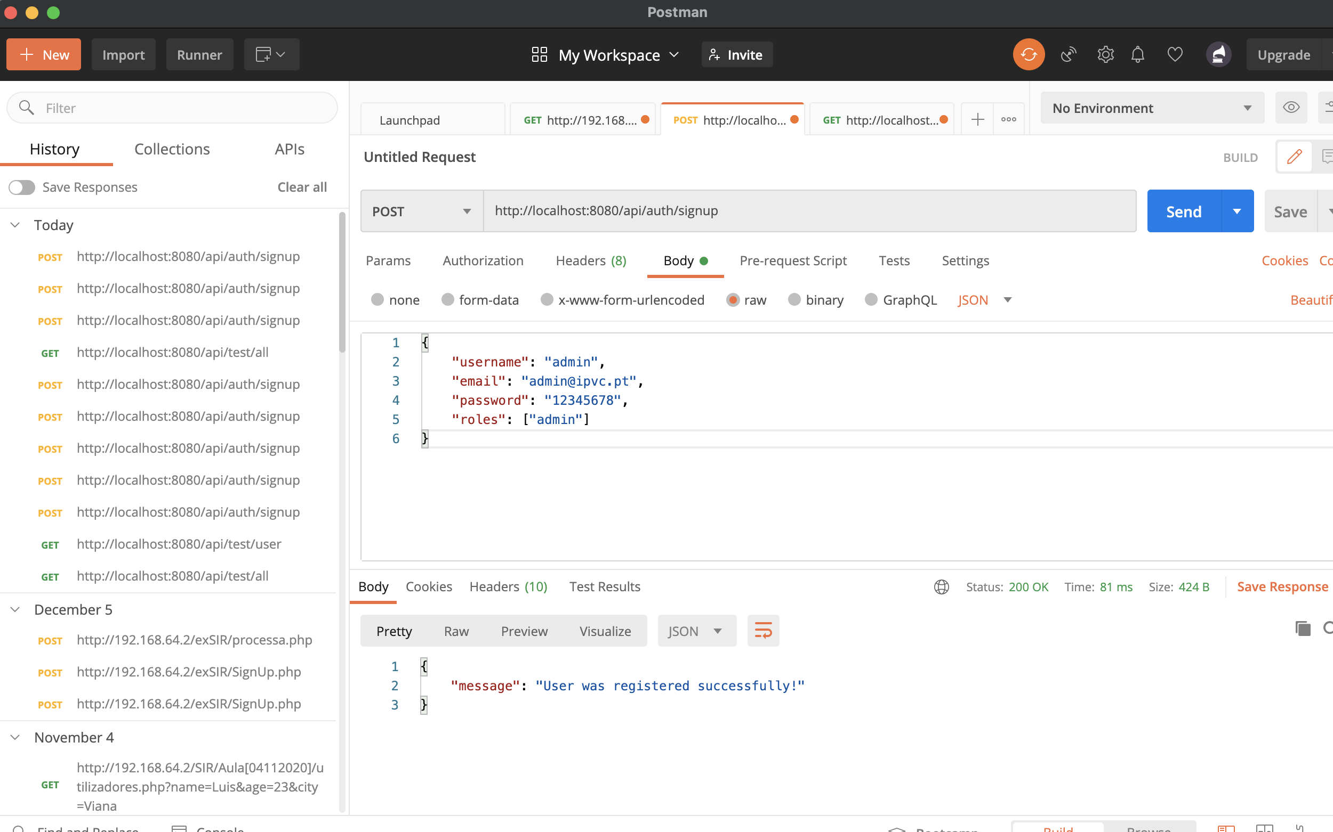
Graduation IN Informatics engineering
5. Postman Testing
Project III
@2020/2021 – Luis Alonso 17506– Backend Node.js, Express, MySQL
- 30 -

Slide 31
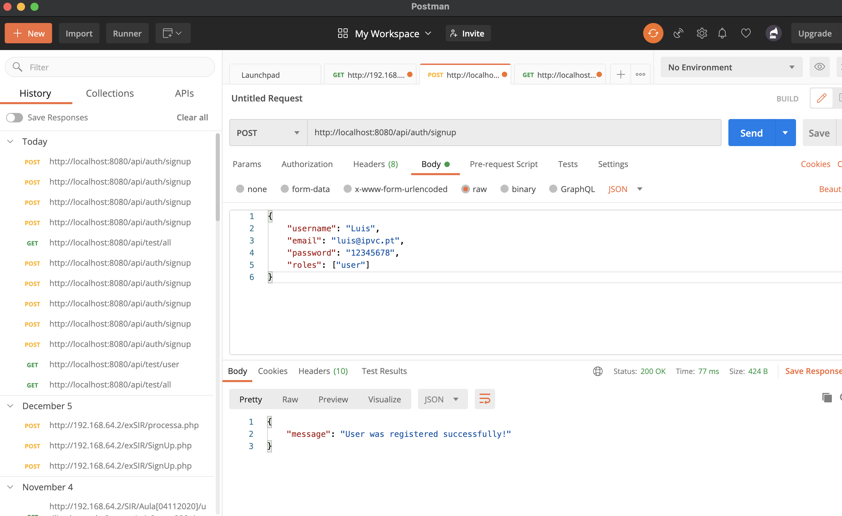
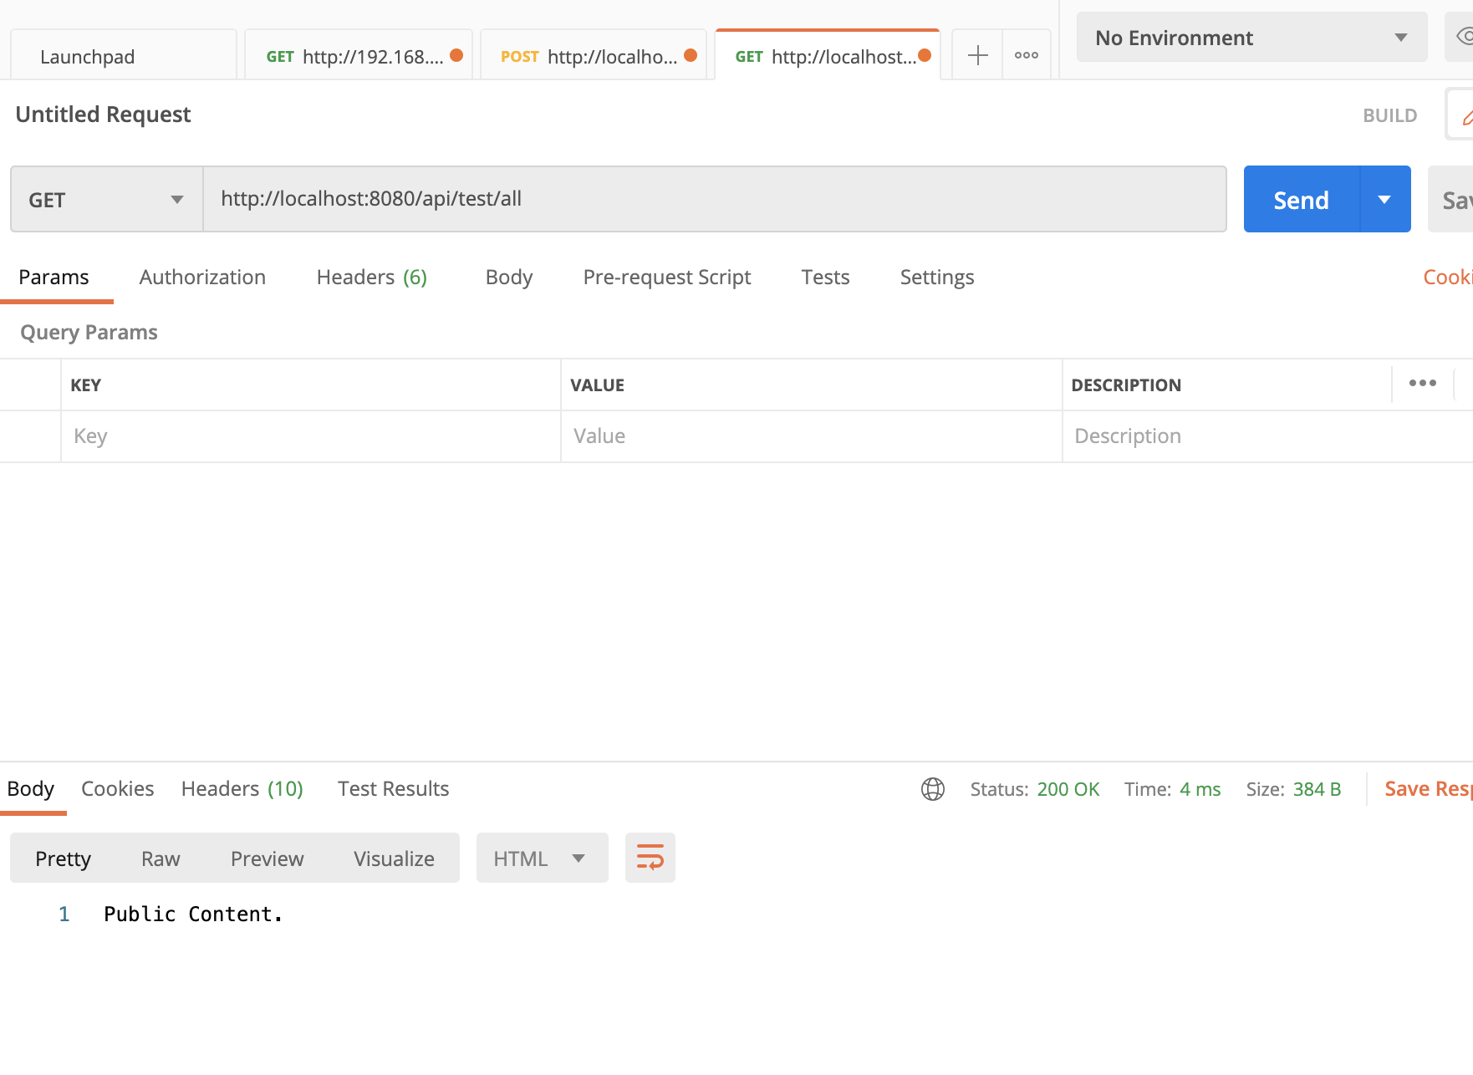
Graduation IN Informatics engineering
5. Postman Testing
Project III
@2020/2021 – Luis Alonso 17506– Backend Node.js, Express, MySQL
- 31 -

Slide 32
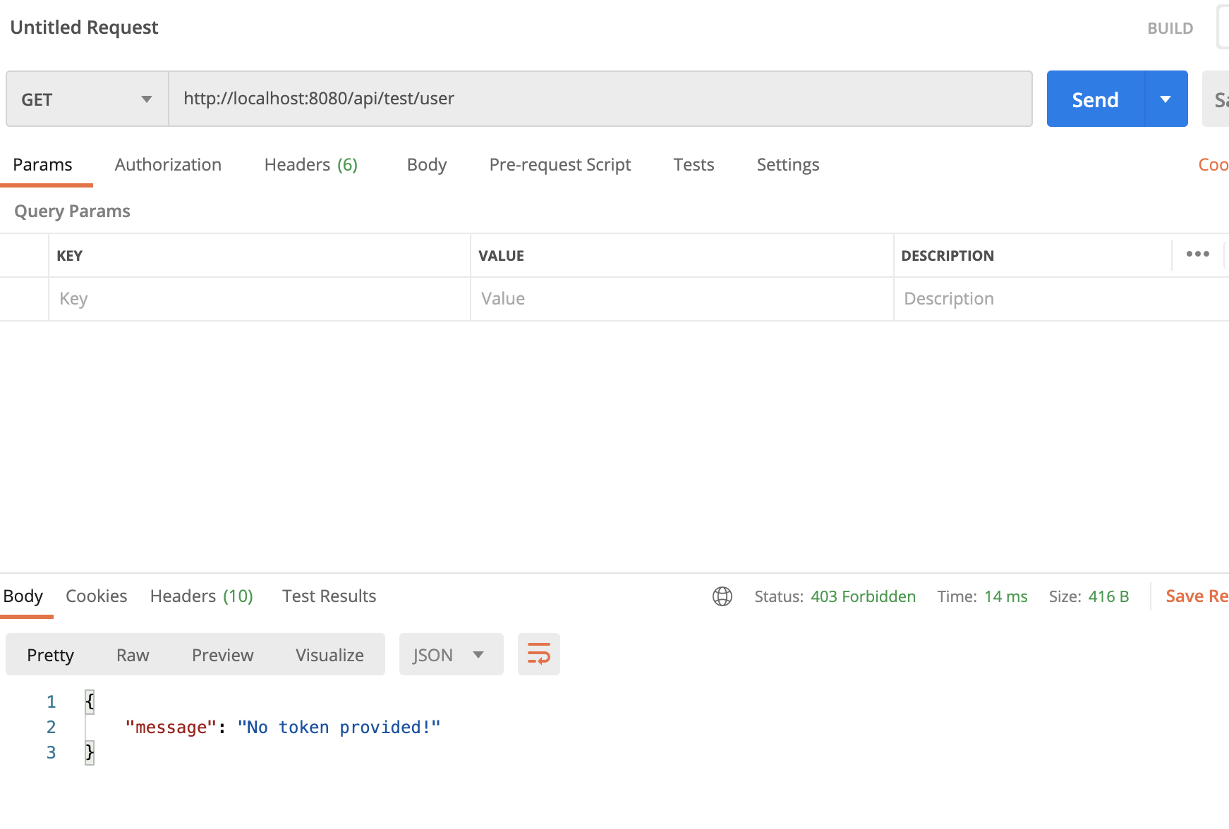
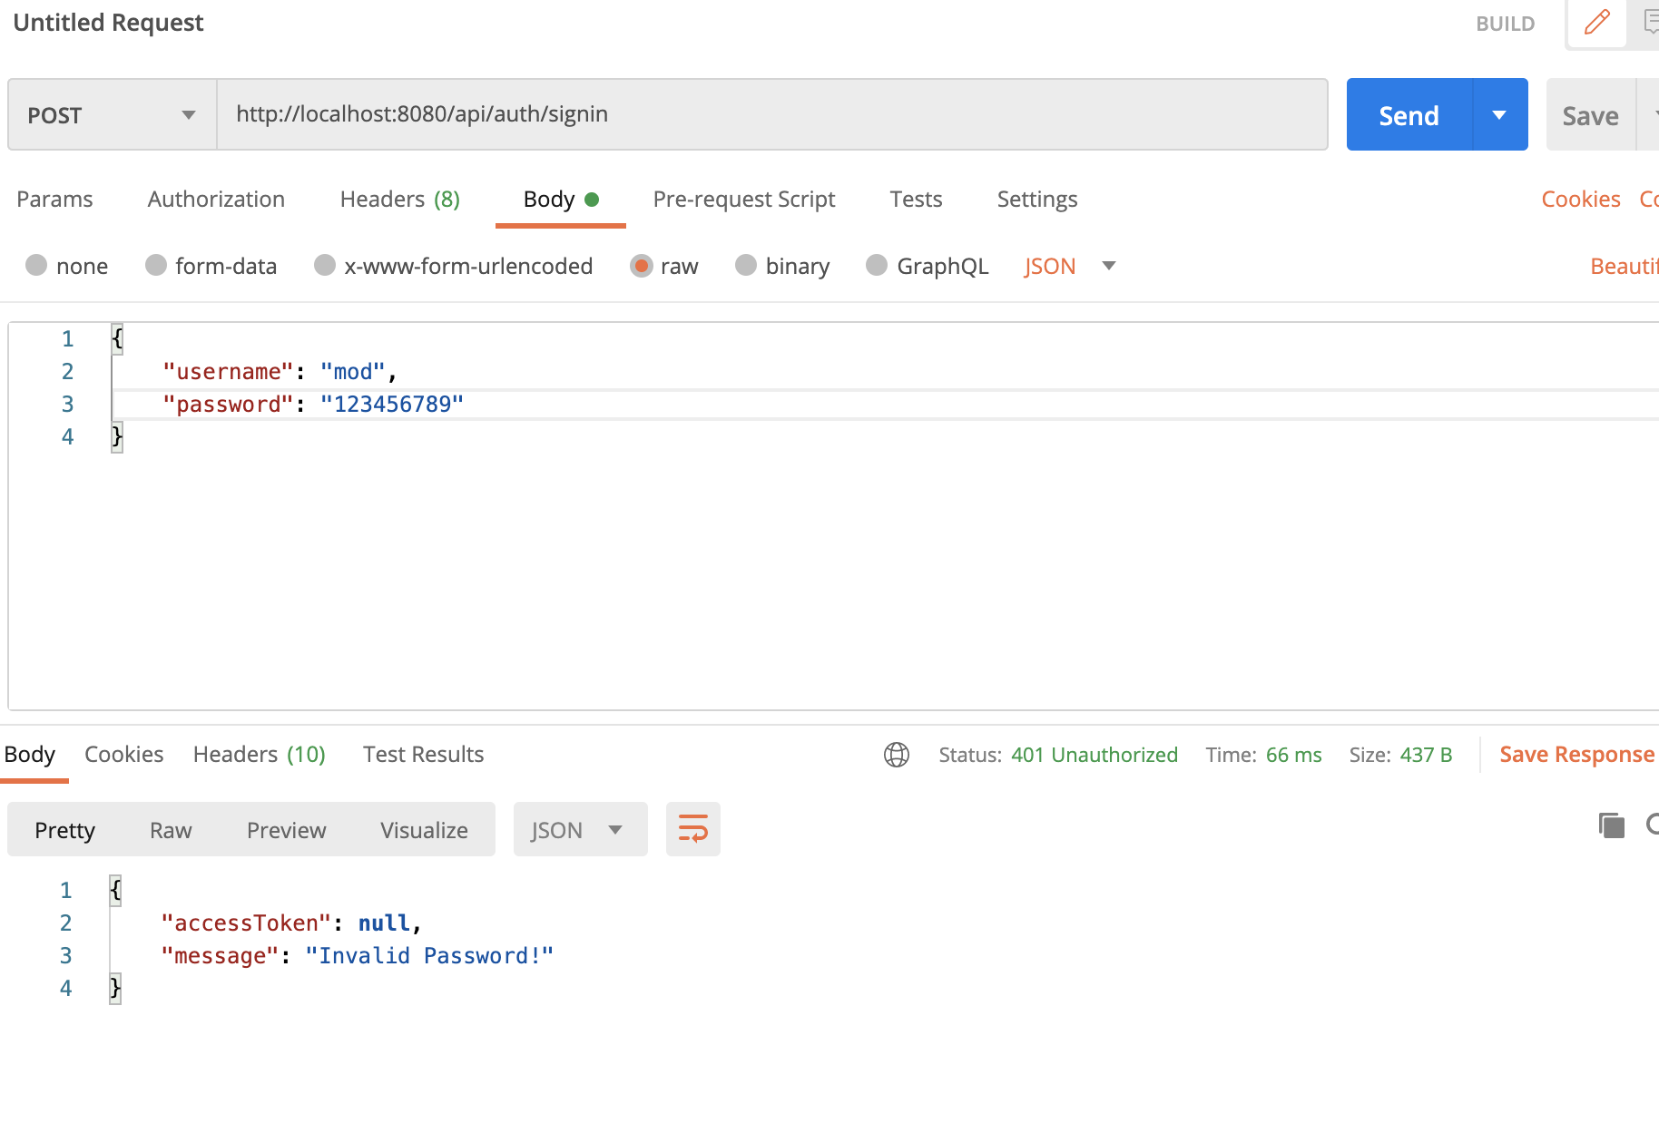
Graduation IN Informatics engineering
5. Postman Testing
Project III
@2020/2021 – Luis Alonso 17506– Backend Node.js, Express, MySQL
- 32 -

Slide 33
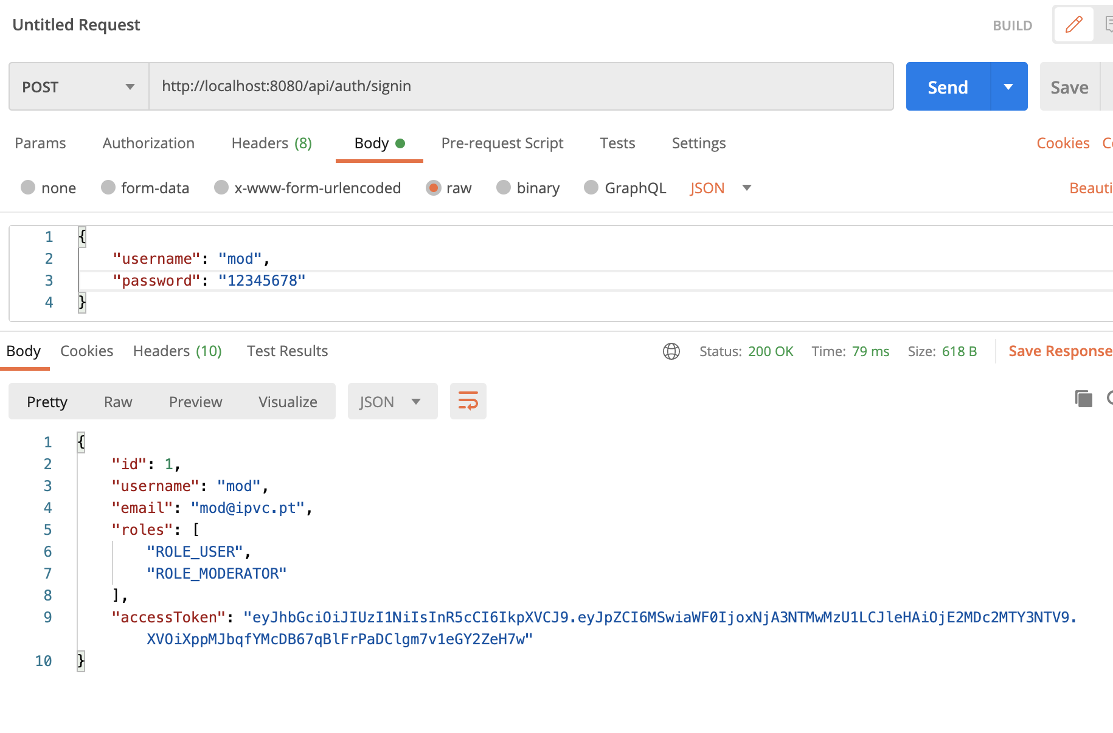
Graduation IN Informatics engineering
5. Postman Testing
Project III
@2020/2021 – Luis Alonso 17506– Backend Node.js, Express, MySQL
- 33 -

Slide 34
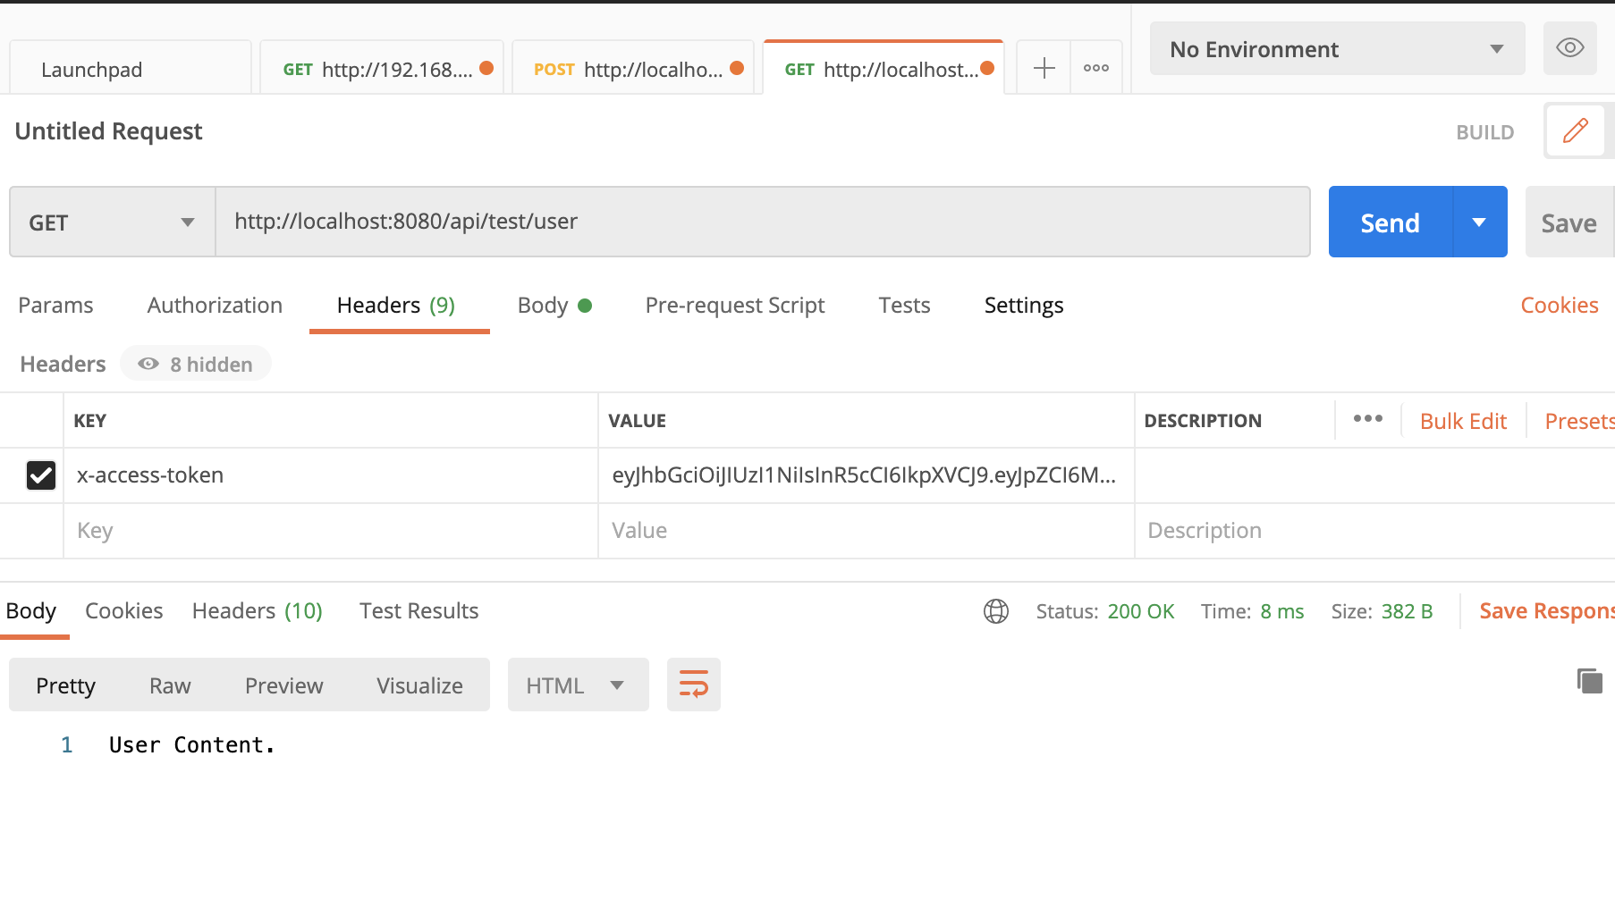
Graduation IN Informatics engineering
5. Postman Testing
Project III
@2020/2021 – Luis Alonso 17506– Backend Node.js, Express, MySQL
- 34 -

Slide 35
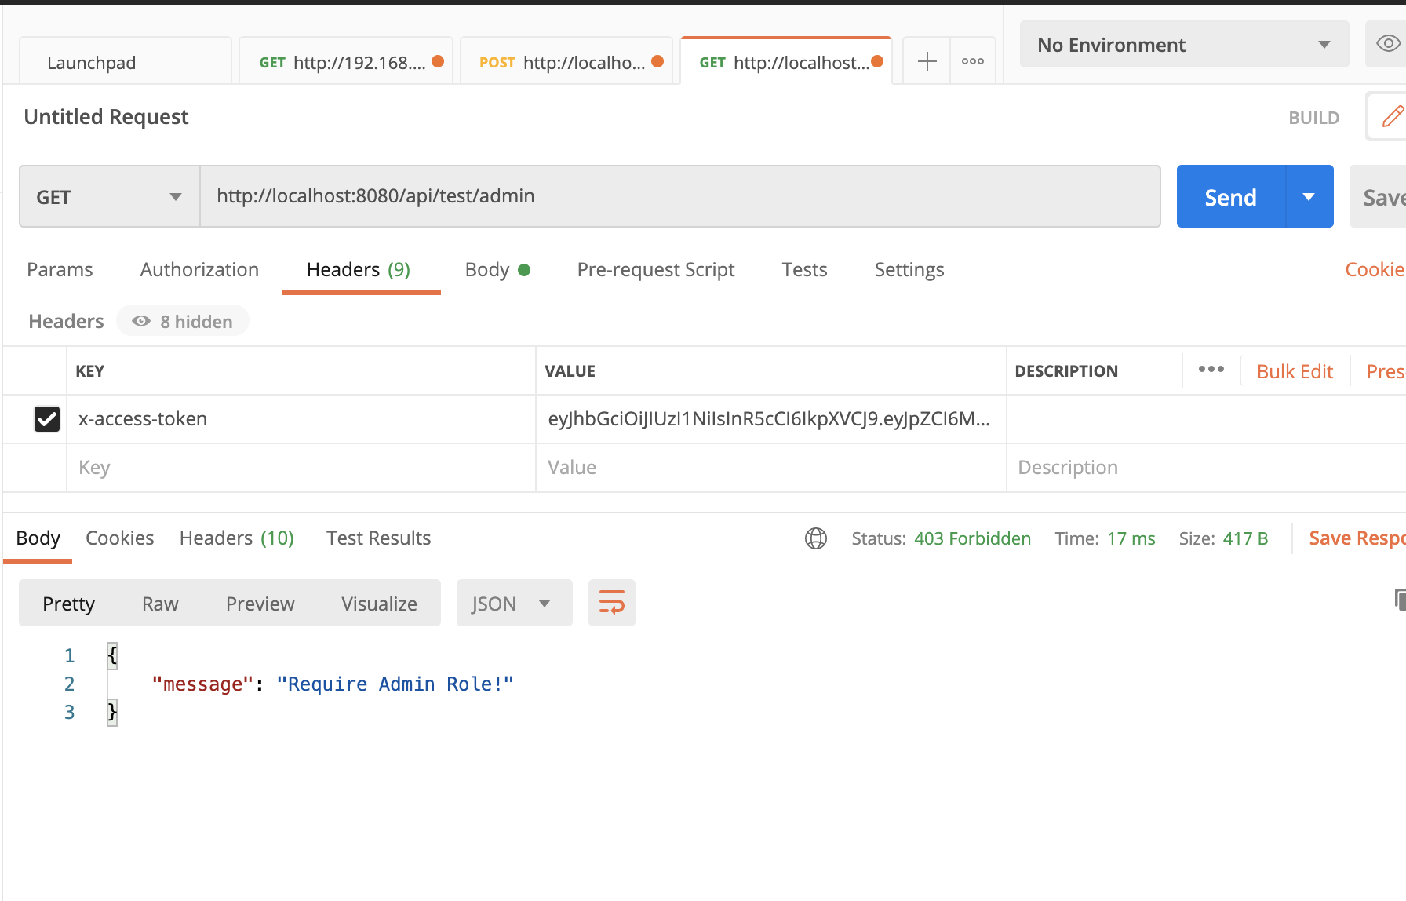
Graduation IN Informatics engineering
5. Postman Testing
Project III
@2020/2021 – Luis Alonso 17506– Backend Node.js, Express, MySQL
- 35 -

Slide 36
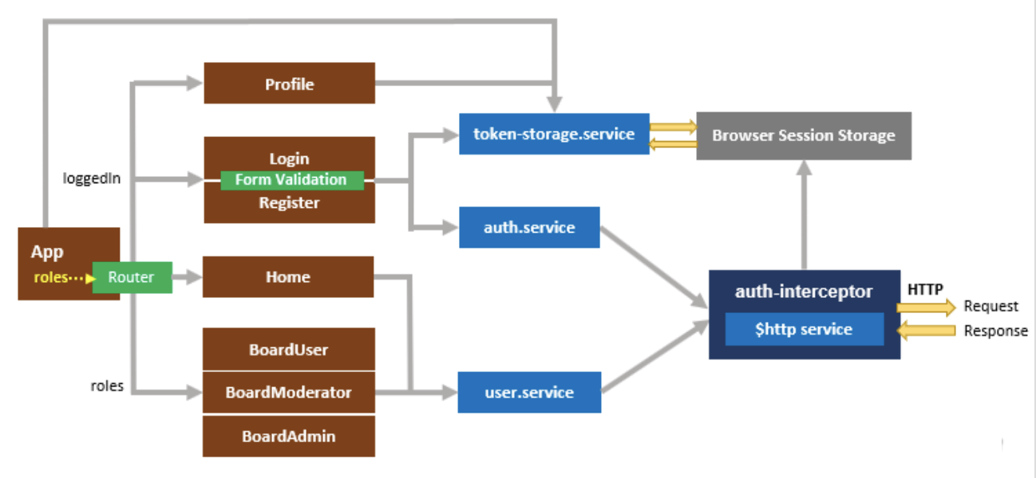
Graduation IN Informatics engineering
6. Angular Implementation
Project III
Front End Structure
@2020/2021 – Luis Alonso 17506– Backend Node.js, Express, MySQL, Angular
- 36 -

Slide 37
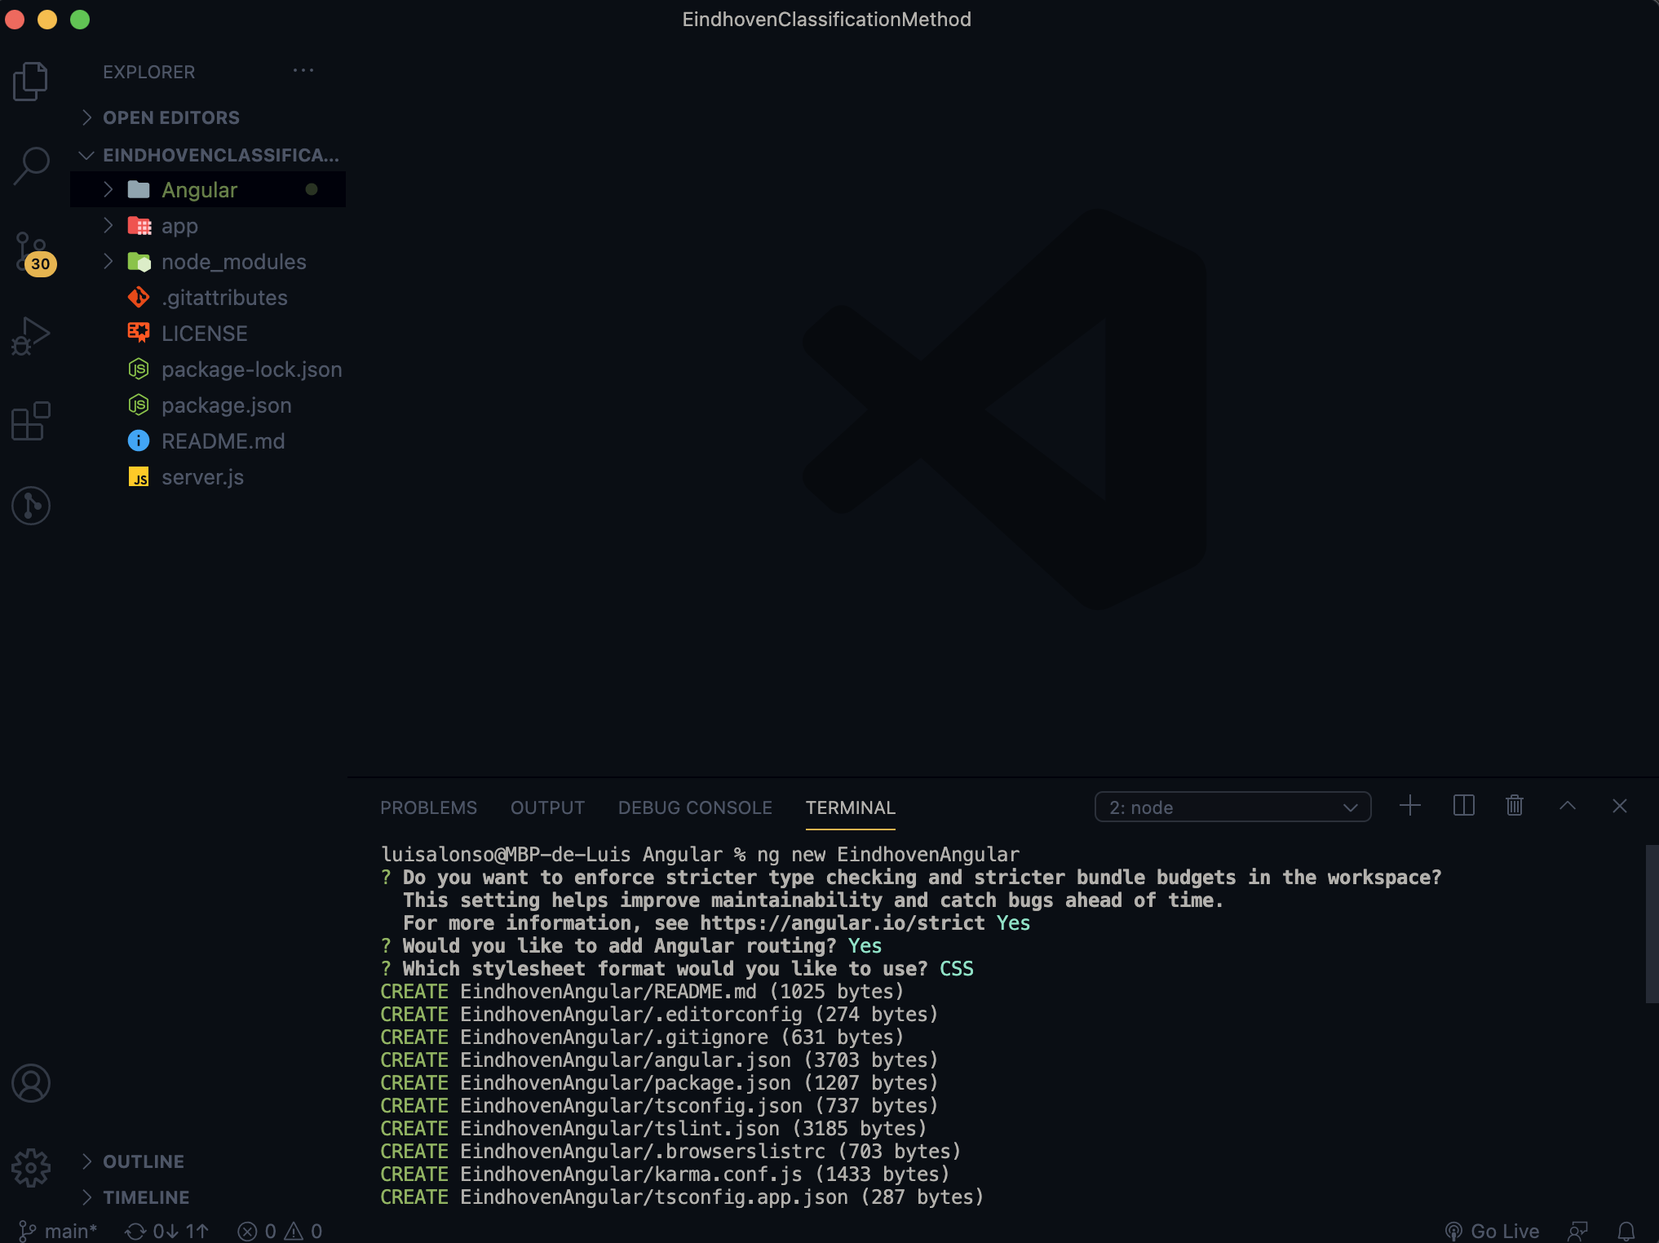
Graduation IN Informatics engineering
6. Angular Implementation
Project III
Creating Angular Project
@2020/2021 – Luis Alonso 17506– Backend Node.js, Express, MySQL, Angular
- 37 -

Slide 38
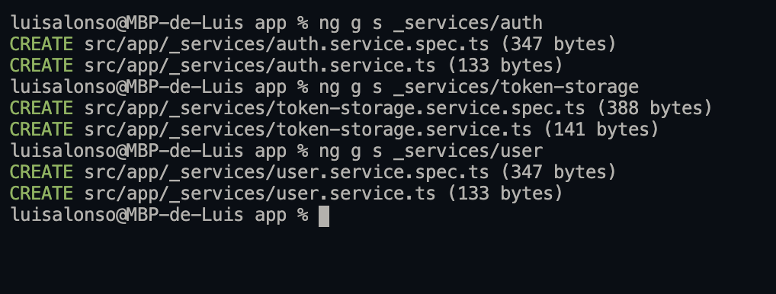
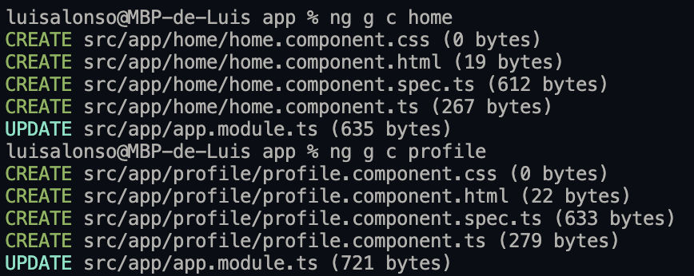
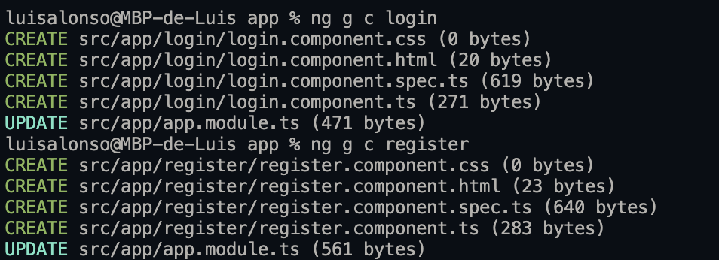
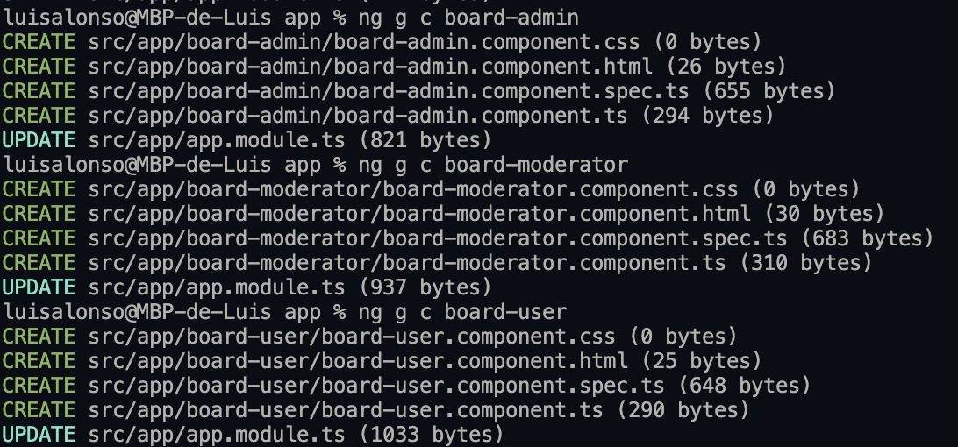
Graduation IN Informatics engineering
6. Angular Implementation
Project III
Create Directories with the Angular Commands
@2020/2021 – Luis Alonso 17506– Backend Node.js, Express, MySQL, Angular
- 38 -

Slide 39
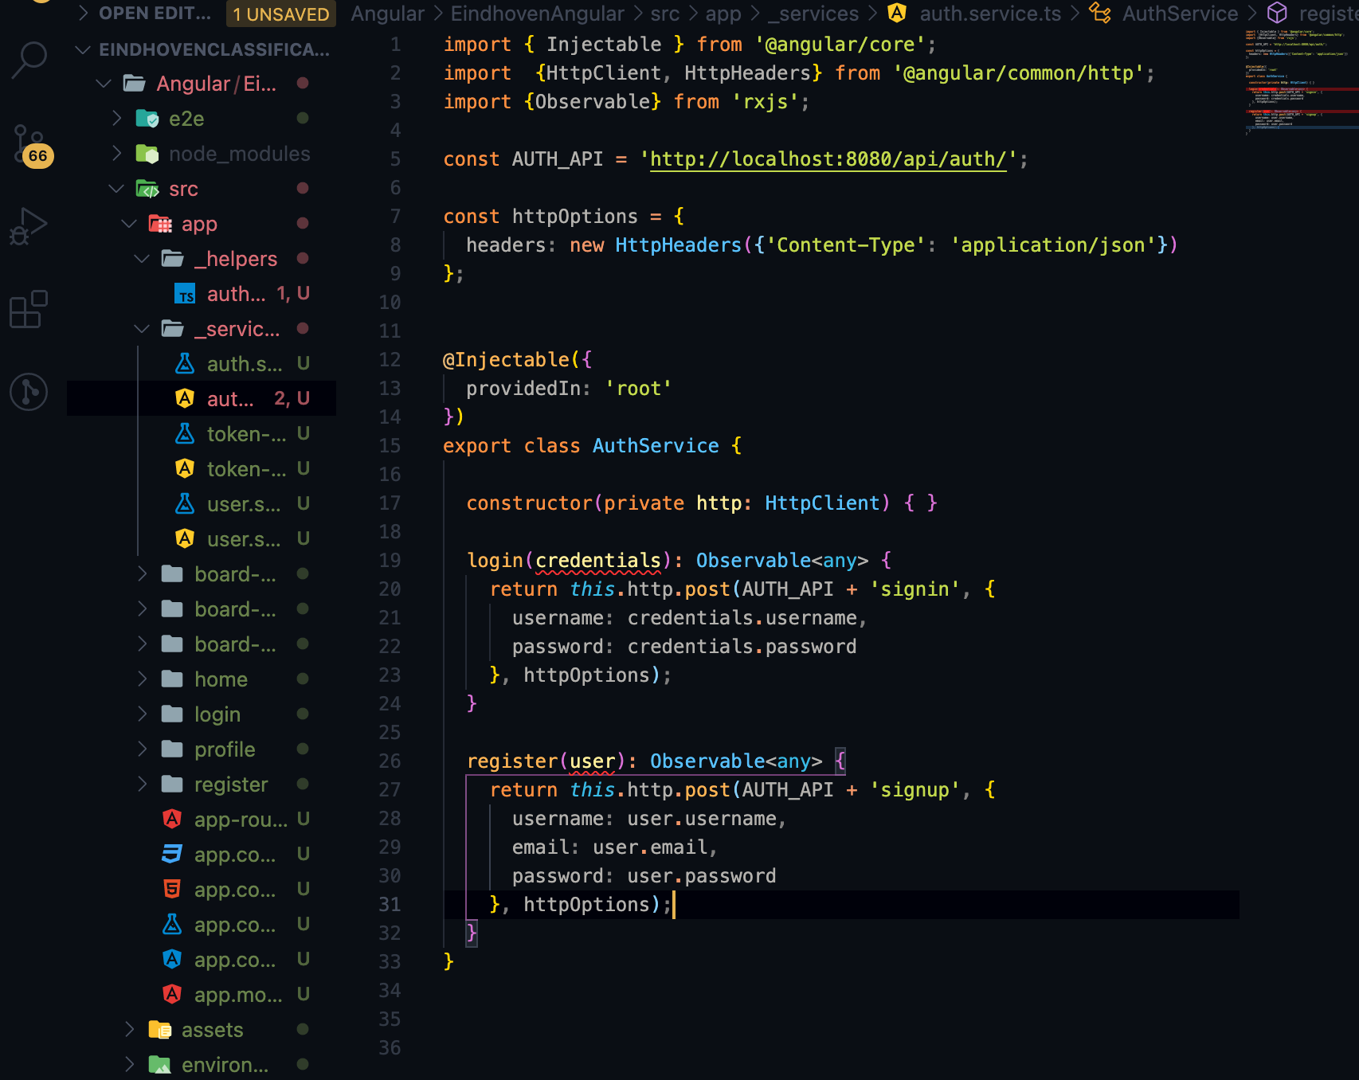
Graduation IN Informatics engineering
6. Angular Implementation
Project III
Authentication Service Sends POST requests to back-end.
@2020/2021 – Luis Alonso 17506– Backend Node.js, Express, MySQL, Angular
- 39 -

Slide 40
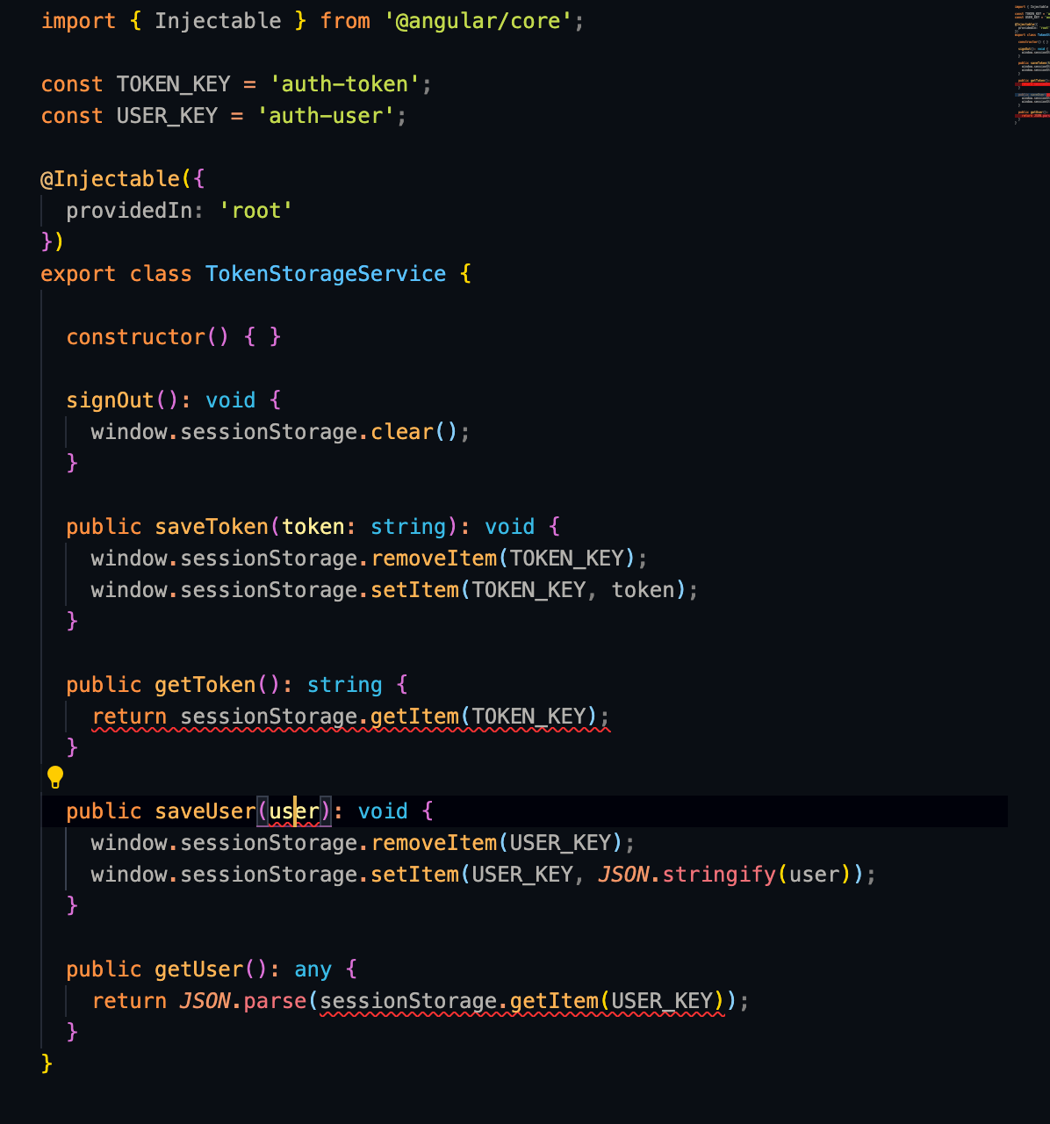
Graduation IN Informatics engineering
6. Angular Implementation
Project III
Token Storage Service : TokenStorageService manages the token and user information (username, email, roles) inside Browser’s Session Storage.
@2020/2021 – Luis Alonso 17506– Backend Node.js, Express, MySQL, Angular
- 40 -

Slide 41
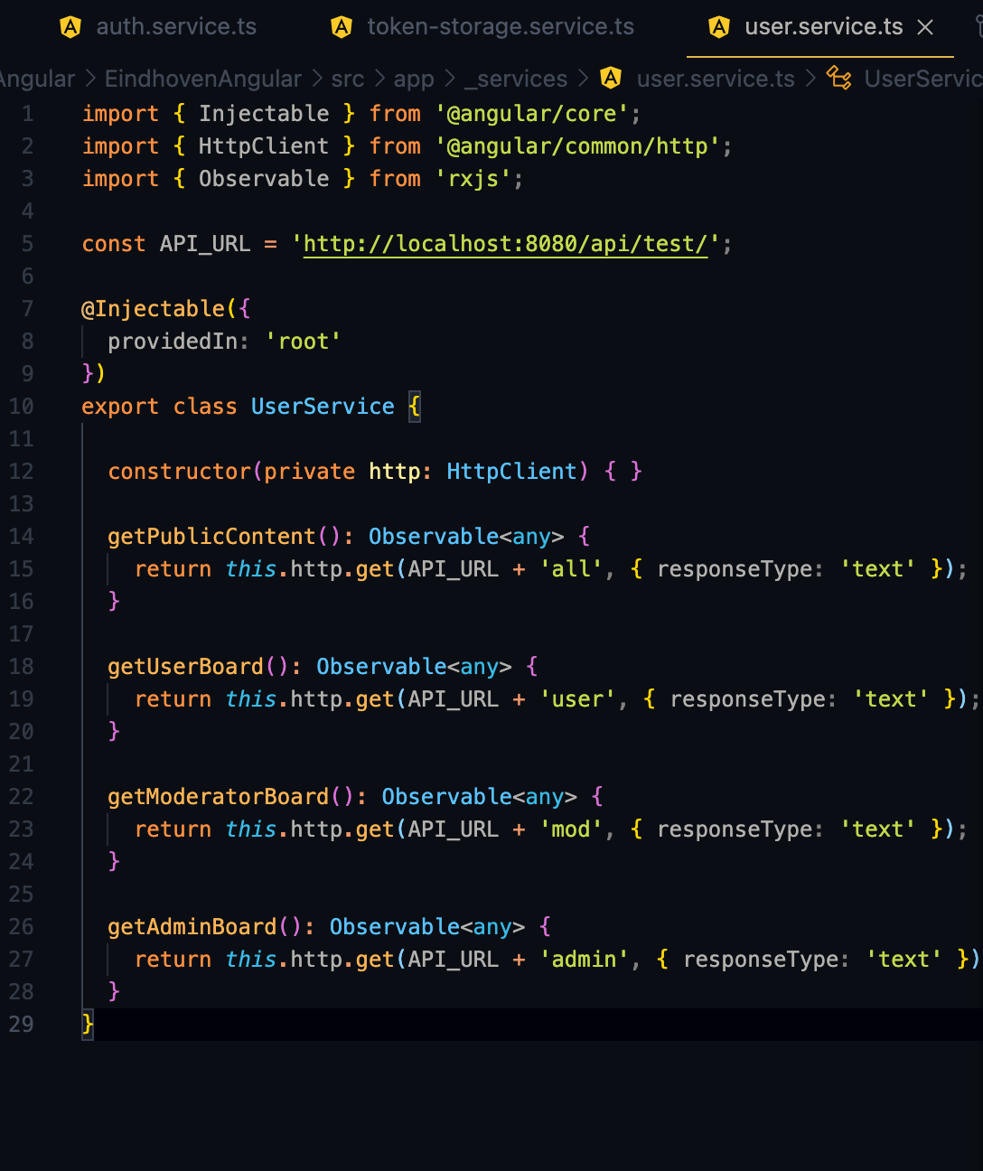
Graduation IN Informatics engineering
6. Angular Implementation
Project III
Data Service Using HTTPInterceptor
This service provides methods to access public and protected resources, depending if the user is na Admin, Moderator or just a regular User.
@2020/2021 – Luis Alonso 17506– Backend Node.js, Express, MySQL, Angular
- 41 -

Slide 42
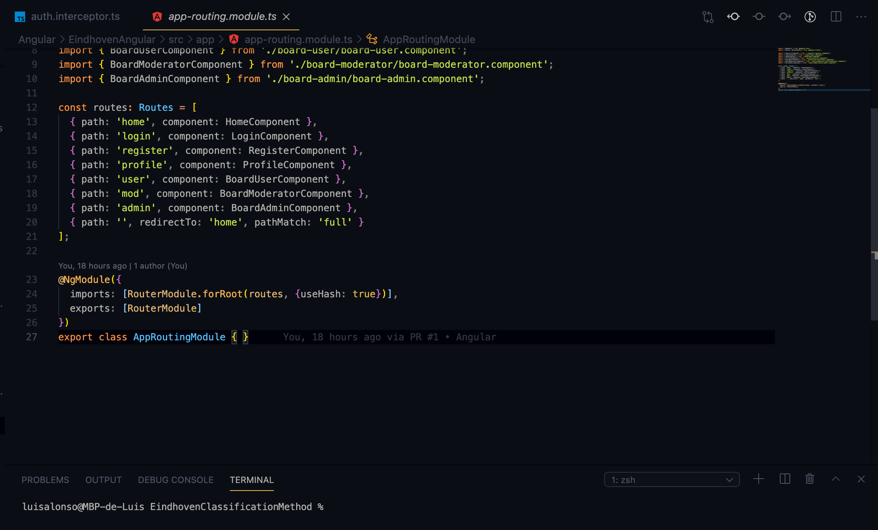
Graduation IN Informatics engineering
6. Angular Implementation
Project III
Routing Components
@2020/2021 – Luis Alonso 17506– Backend Node.js, Express, MySQL
- 42 -

Slide 43
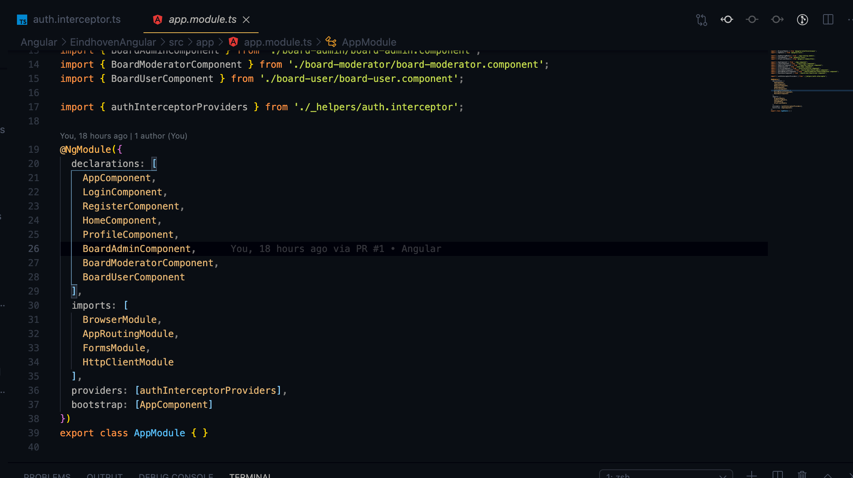
Graduation IN Informatics engineering
6. Angular Implementation
Project III
App Modules and Bootstrap
@2020/2021 – Luis Alonso 17506– Backend Node.js, Express, MySQL
- 43 -

Slide 44
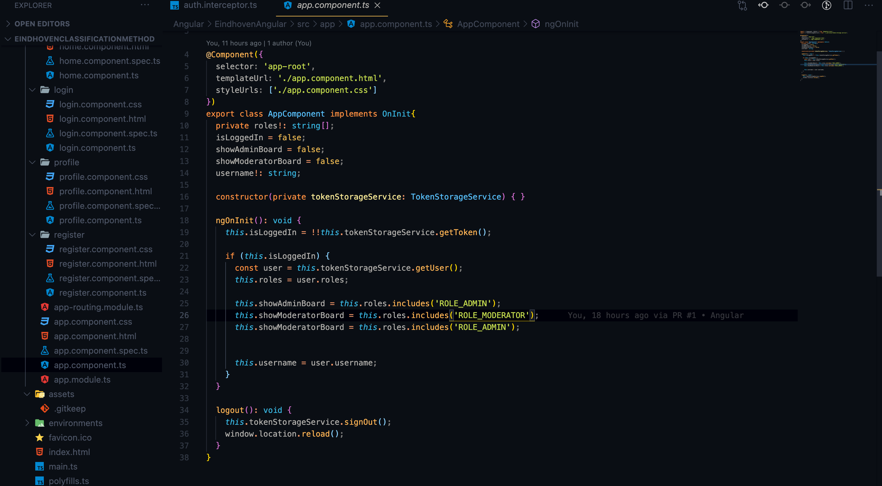
Graduation IN Informatics engineering
6. Angular Implementation
Project III
App Component.ts , changes the tabs of the app depending of the role of the user. Also, ends the tokenStorageService.
@2020/2021 – Luis Alonso 17506– Backend Node.js, Express, MySQL
- 44 -

Slide 45
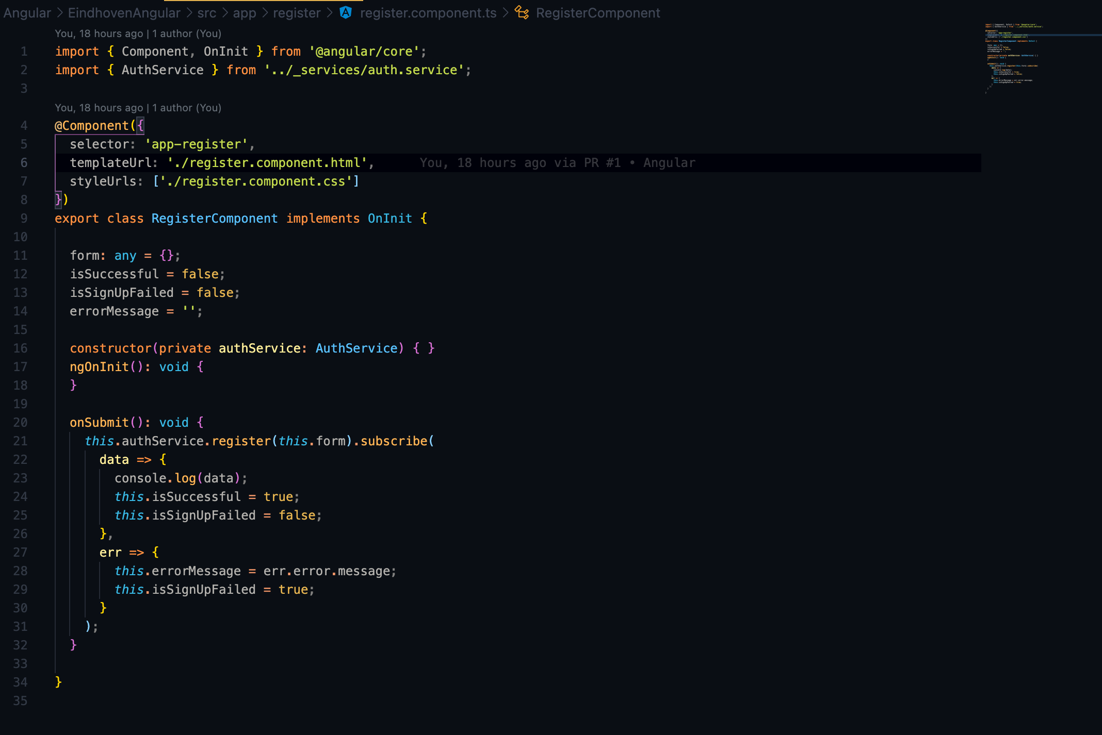
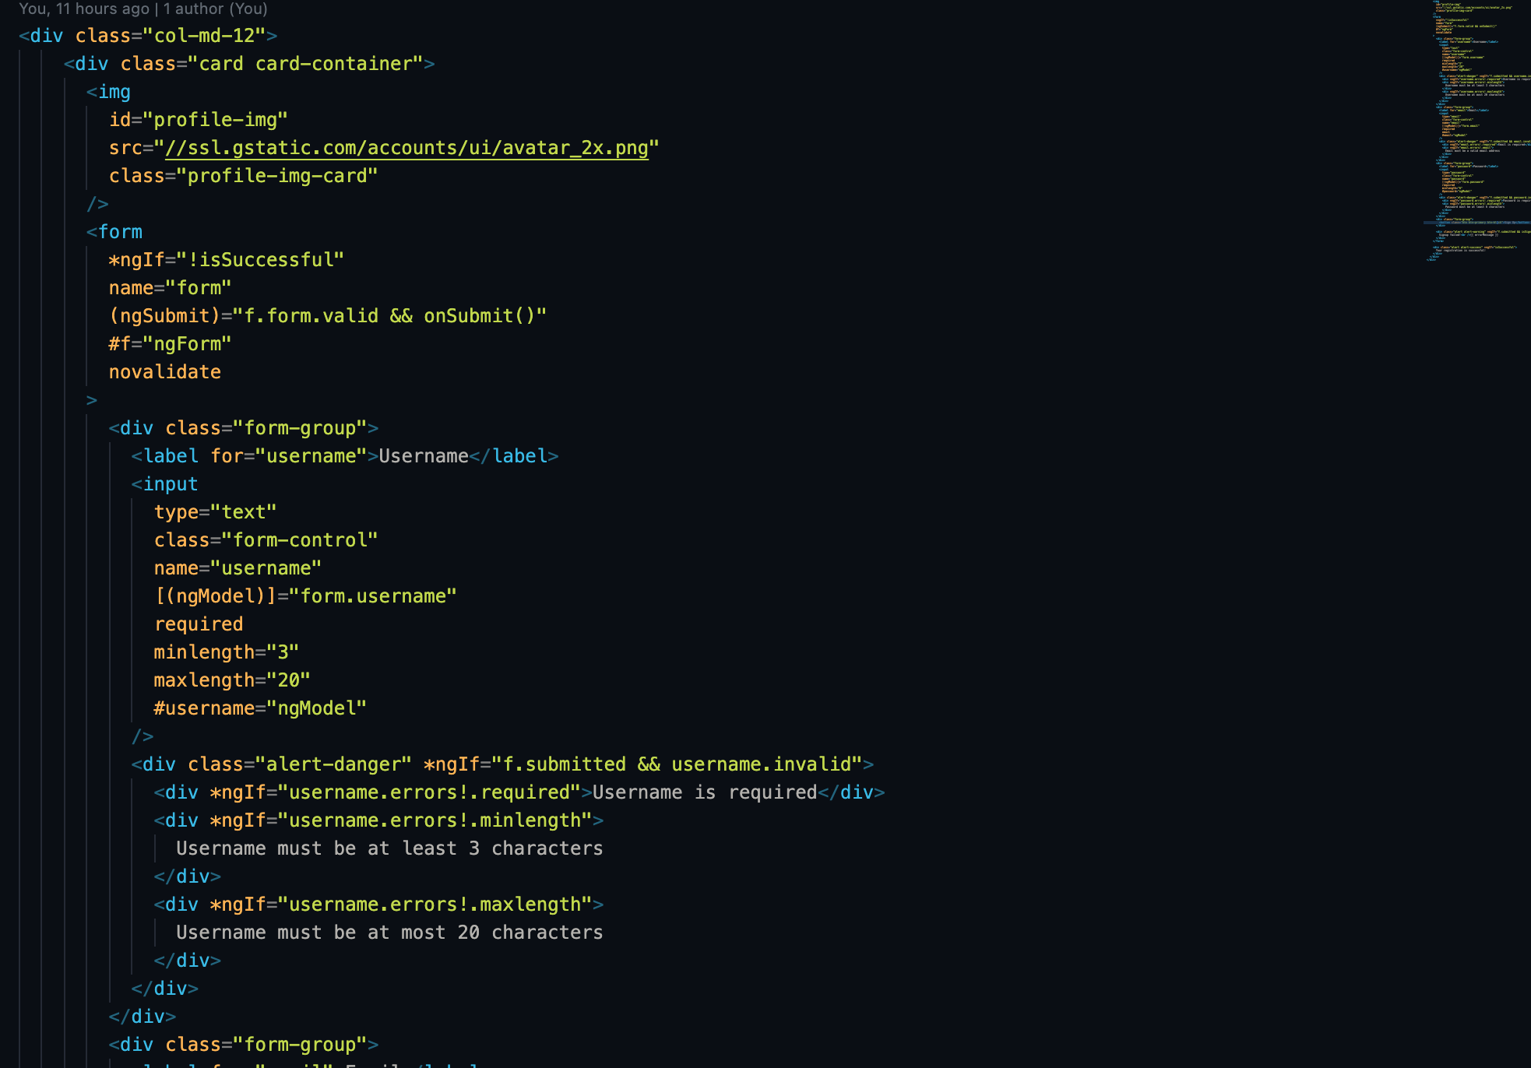
Graduation IN Informatics engineering
6. Angular Implementation
Project III
Register.ts and HTML, is has the register functions and the restrictions on the HTML input fields, using the *ngIf statemtents.
@2020/2021 – Luis Alonso 17506– Backend Node.js, Express, MySQL
- 45 -

Slide 46
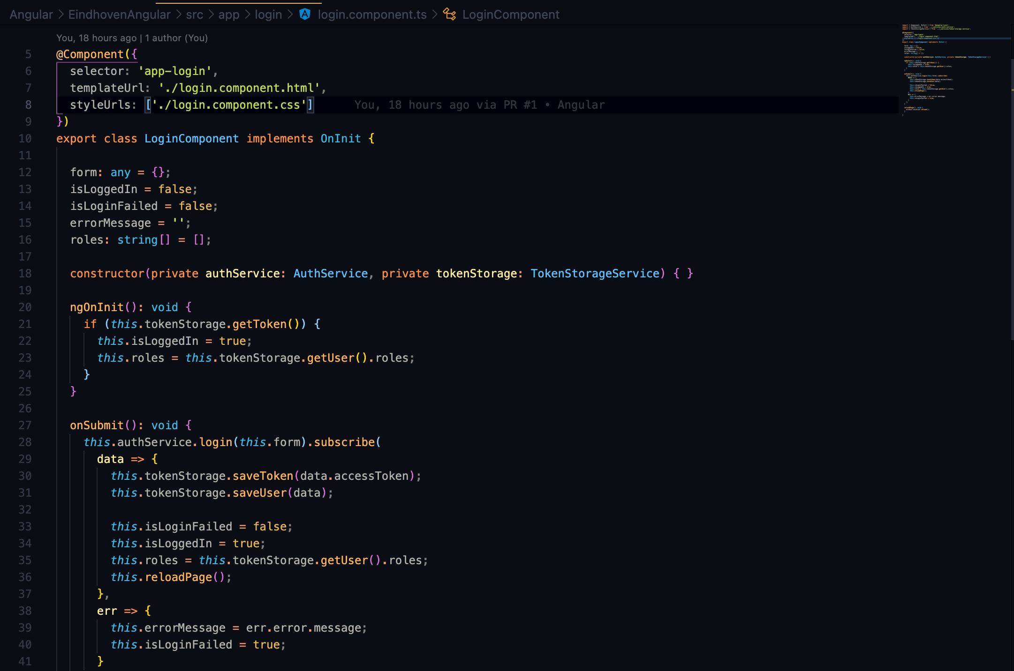

Graduation IN Informatics engineering
6. Angular Implementation
Project III
Login.ts and HTML, is has the login functions and the restrictions on the HTML input fields, using the *ngIf statemtents, for exemple, it gives a warning if the username input is void with *ngIf= “f.submitted && username.invalid”.
@2020/2021 – Luis Alonso 17506– Backend Node.js, Express, MySQL
- 46 -

Slide 47


Graduation IN Informatics engineering
6. Angular Implementation
Project III
Basic HomeComponent, showing only the public content of the app.
@2020/2021 – Luis Alonso 17506– Backend Node.js, Express, MySQL
- 47 -

Slide 48


Graduation IN Informatics engineering
6. Angular Implementation
Project III
Board Admin Page, checks if the user is na Admin,
and provides acess to the Admin content of the app.
@2020/2021 – Luis Alonso 17506– Backend Node.js, Express, MySQL
- 48 -

Slide 49
Graduation IN Informatics engineering
6. Angular Implementation
Project III
@2020/2021 – Luis Alonso 17506– Backend Node.js, Express, MySQL
- 49 -

Slide 50

Graduation IN Informatics engineering
7. GitHub Repository
Project III
@2020/2021 – Luis Alonso 17506– Backend Node.js, Express, MySQL
- 50 -

Slide 51
Graduation IN Informatics engineering
8. Bibliography and Web References
Project III
https://pplware.sapo.pt/tutoriais/node-js-aprenda-criar-um-servidor-web-menos-1-minuto/
https://developer.mozilla.org/pt-PT/docs/Web/HTTP/CORS
https://www.luiztools.com.br/post/tutorial-de-crud-com-node-js-sequelize-e-mysql/
https://www.tutorialspoint.com/expressjs/expressjs_overview.htm
https://expressjs.com
https://searchoracle.techtarget.com/definition/MySQL
http://expressjs.com/en/resources/middleware/body-parser.html
https://bezkoder.com/node-js-jwt-authentication-mysql/
https://sequelize.org
https://jwt.io
https://github.com/dcodeIO/bcrypt.js#usage---async
https://nodejs.org/en/
@2020/2021 – Luis Alonso 17506– Backend Node.js, Express, MySQL
- 51 -

Slide 52
Graduation IN Informatics engineering
Backend Node.js, Express, MySQL
■ Course Unit: Project III
Luís Alonso 17506
■ Coordinator: Prof. Doctor Jorge Ribeiro
Instituto Politécnico de Viana do Castelo
Escola Superior de Tecnologia e Gestão
www.ipvc.pt
School Year: 2020/2021

